Slide 1
TUTORIAL CLASS (Physics 4 – Midterm)
Truong Le Gia Bao – SESEIU17001

Slide 2
Outline
Chapter 1:Wave
Chapter 2: Light
Review

Slide 3
Chapter 1: wave

Slide 4

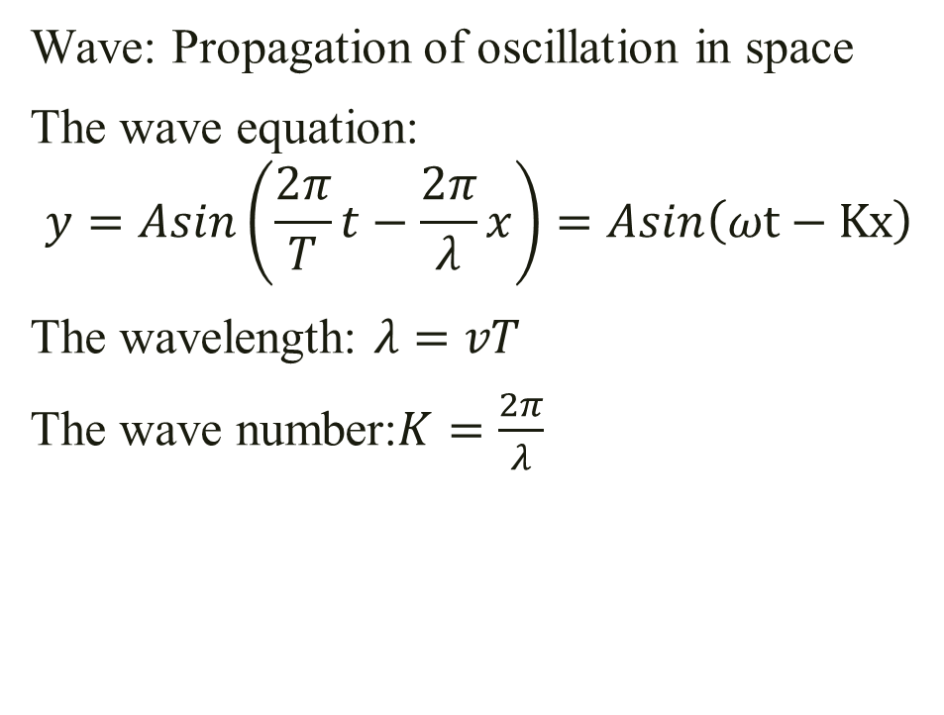
1.Mechanical Wave 1.1 The wave equation
Wave: Propagation of oscillation in space
The wave equation:
$$y=Asin\left(\frac{2π}{T}t−\frac{2π}{λ}x\right)=Asin\left(ωt−Kx\right)$$
The wavelength: $λ=vT$
The wave number:$K=\frac{2π}{λ}$

Slide 5
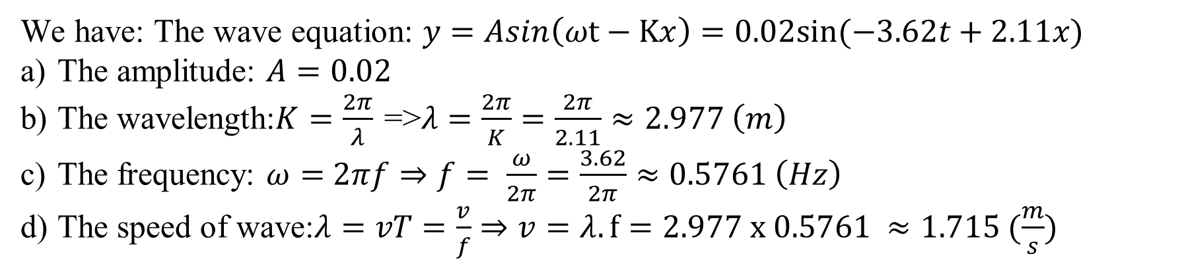
A wave is described by y = 0.020 0 sin (kx - vt), where k = 2.11 rad/m, v = 3.62 rad/s, x and y are in meters, and t is in seconds. Determine (a) the amplitude, (b) the wavelength, (c) the frequency, and (d) the speed of the wave
[Extra Problem – Wave]
We have: The wave equation: $y=Asin\left(ωt−Kx\right)=0.02sin⁡(−3.62t+2.11x)$
The amplitude: $A=0.02$
The wavelength:$K=\frac{2π}{λ}$ =>$λ=\frac{2π}{K}=\frac{2π}{2.11}≈2.977 \left(m\right)$
The frequency: $ω=$ $2πf⇒f= \frac{ω}{2π}=\frac{3.62}{2π}≈0.5761 \left(Hz\right)$
The speed of wave:$λ=vT=\frac{v}{f}⇒v=λ.f=2.977 x 0.5761 ≈1.715 (\frac{m}{s})$

Slide 6

1.Mechanical Wave 1.2 The speed of wave on a string
The speed of waves on strings:
$$v=\sqrt{\frac{T}{μ}}$$
T: the tension of the string
$μ:$ mass per unit length (kg/m)

Slide 7
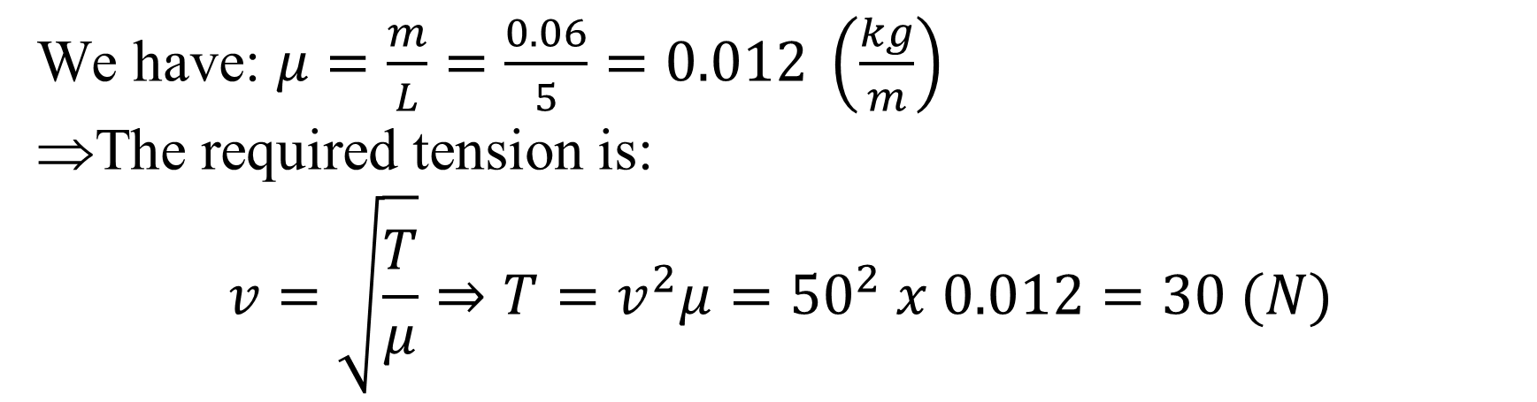
Transverse waves with a speed of 50.0 m/s are to be produced in a taut string. A 5.00-m length of string with a total mass of 0.060 0 kg is used. What is the required tension?
[Extra Problem – Wave]
We have: $μ=\frac{m}{L}=\frac{0.06}{5}=0.012 \left(\frac{kg}{m}\right)$
The required tension is:
$$v=\sqrt{\frac{T}{μ}}⇒T=v^{2}μ={50}^{2} x 0.012=30 (N)$$

Slide 8
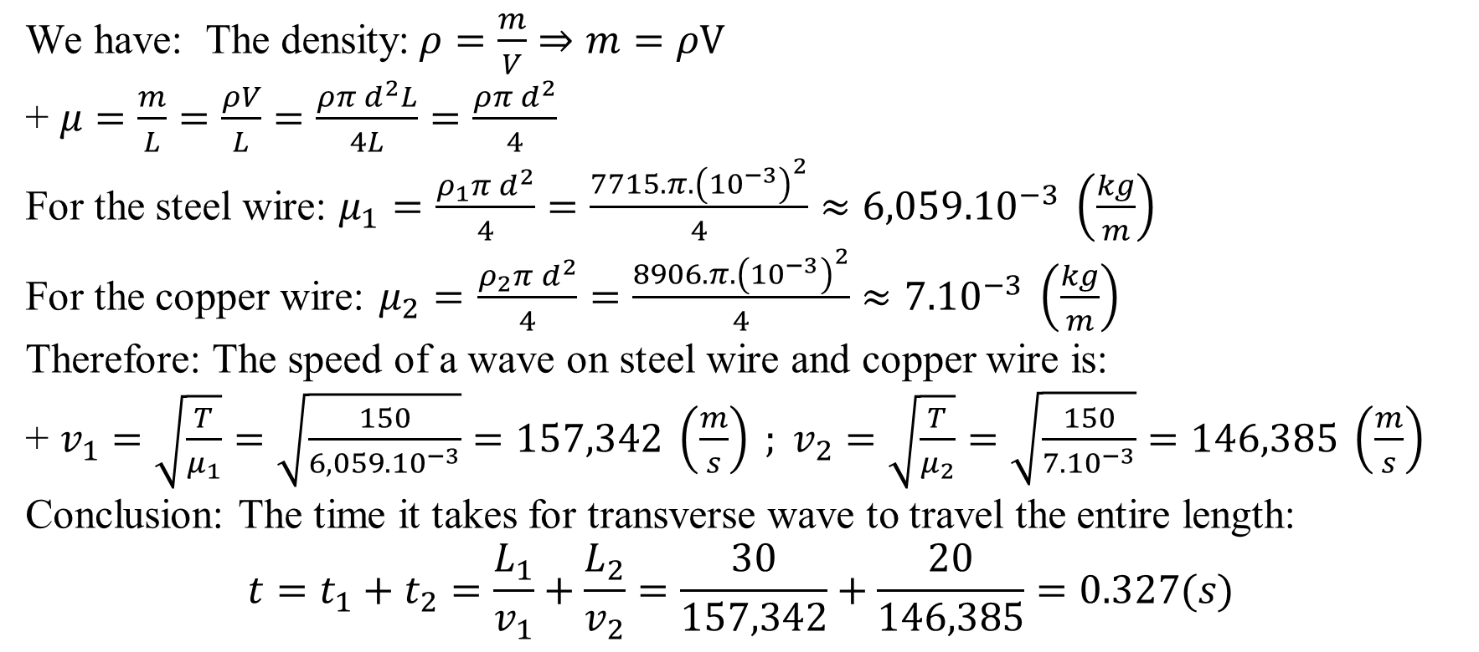
A 30.0-m steel wire and a 20.0-m copper wire, both with 1.00-mm diameters, are connected end to end and are stretched to a tension of 150 N. How long does it take a transverse wave to travel the entire length of the two wires?
[Extra Problem – Wave]
We have: The density:$ρ=\frac{m}{V}⇒m=ρV$
+ $μ=\frac{m}{L}=\frac{ρV}{L}=\frac{ρπⅆ^{2}L}{4L}=\frac{ρπⅆ^{2}}{4}$
For the steel wire: $μ_{1}=$ $\frac{ρ_{1}πⅆ^{2}}{4}=\frac{7715.π.{\left({10}^{−3}\right)}^{2}}{4}≈{6,059.10}^{−3} \left(\frac{kg}{m}\right)$
For the copper wire: $μ_{2}=$ $\frac{ρ_{2}πⅆ^{2}}{4}=\frac{8906.π.{\left({10}^{−3}\right)}^{2}}{4}≈{7.10}^{−3} \left(\frac{kg}{m}\right)$
Therefore: The speed of a wave on steel wire and copper wire is:
+ $v_{1}=\sqrt{\frac{T}{μ_{1}}}=\sqrt{\frac{150}{{6,059.10}^{−3}}}=157,342 \left(\frac{m}{s}\right) ; v_{2}=\sqrt{\frac{T}{μ_{2}}}=\sqrt{\frac{150}{{7.10}^{−3}}}=146,385 \left(\frac{m}{s}\right)$
Conclusion: The time it takes for transverse wave to travel the entire length:
$$t=t_{1}+t_{2}=\frac{L_{1}}{v_{1}}+\frac{L_{2}}{v_{2}}=\frac{30}{157,342}+\frac{20}{146,385}=0.327(s)$$

Slide 9
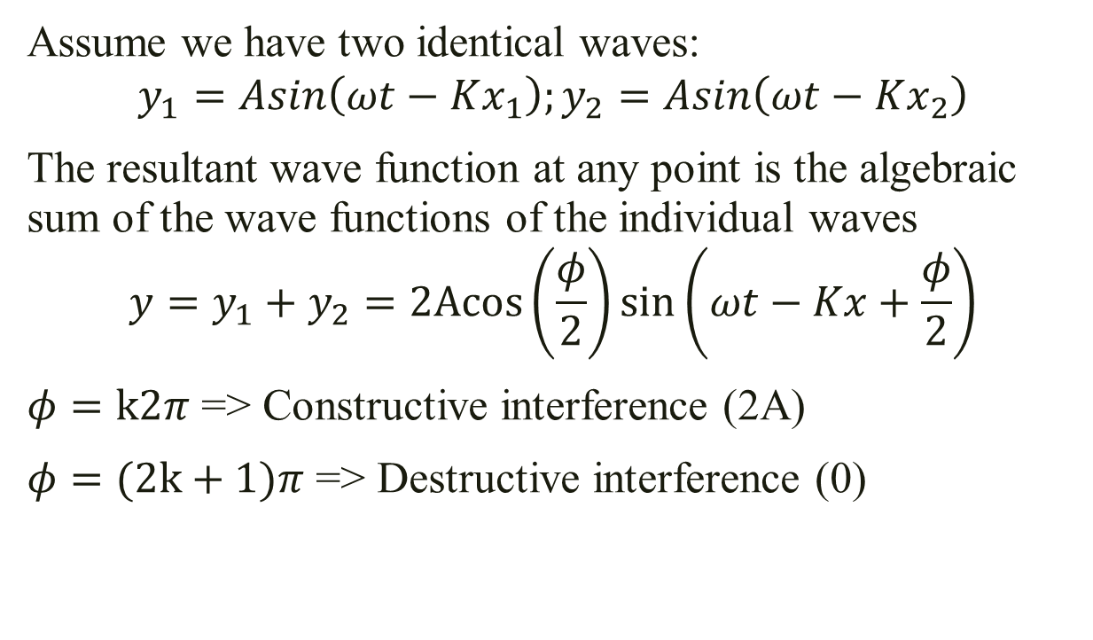
1.Mechanical Wave 1.3 Interference
Assume we have two identical waves:
$$y_{1}=Asin\left(ωt−Kx_{1}\right);y_{2}=Asin\left(ωt−Kx_{2}\right)$$
The resultant wave function at any point is the algebraic sum of the wave functions of the individual waves
$$y=y_{1}+y_{2}=2Acos\left(\frac{φ}{2}\right)sin\left(ωt−Kx+\frac{φ}{2}\right)$$
$φ=k2π$ => Constructive interference (2A)
$φ=(2k+1)π$ => Destructive interference (0)
M
x₁
x₂
S₁
S₂

Slide 10
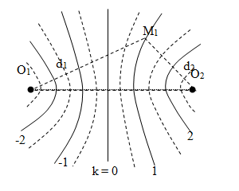
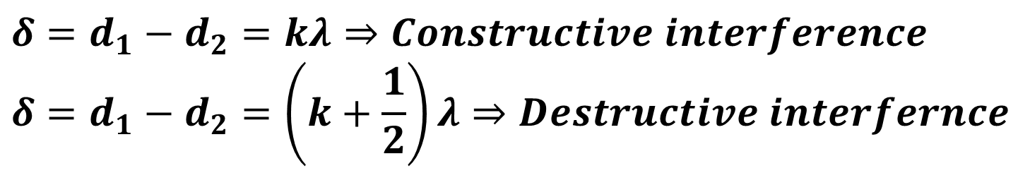
1.Mechanical Wave 1.3 Interference
$$δ=d_{1}−d_{2}=kλ⇒Constructive interference$$
$$δ=d_{1}−d_{2}=\left(k+\frac{1}{2}\right)λ⇒Destructive interfernce$$

Slide 11
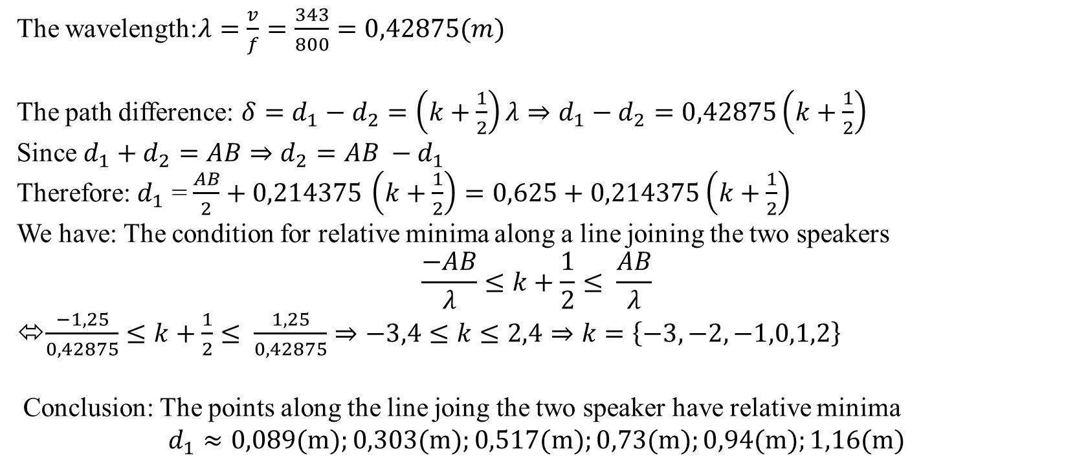
Two speakers are driven by a common oscillator at 800 Hz and face each other at a distance of
1.25 m. Locate the points along a line joining the two speakers where relative minima of sound
pressure would be expected. (Use v = 343 m/s.)
[Extra Problem - Wave]
The wavelength:$λ=\frac{v}{f}=\frac{343}{800}=0,42875(m)$
The path difference: $δ=d_{1}−d_{2}=\left(k+\frac{1}{2}\right)λ⇒d_{1}−d_{2}=0,42875\left(k+\frac{1}{2}\right)$
Since $d_{1}+d_{2}=AB⇒d_{2}=AB −d_{1}$
Therefore: $d_{1}$ = $\frac{AB}{2}+0,214375$ $\left(k+\frac{1}{2}\right)=0,625+0,214375\left(k+\frac{1}{2}\right)$
We have: The condition for relative minima along a line joining the two speakers
$$\frac{−AB}{λ}≤k+\frac{1}{2}≤ \frac{AB}{λ}$$
⬄$\frac{−1,25}{0,42875}≤k+\frac{1}{2}≤ \frac{1,25}{0,42875}⇒−3,4≤k≤2,4⇒k=\left\{−3,−2,−1,0,1,2\right\}$
Conclusion: The points along the line joing the two speaker have relative minima
$$d_{1}≈0,089(m);0,303(m);0,517(m);0,73(m);0,94(m);1,16(m)$$

Slide 12
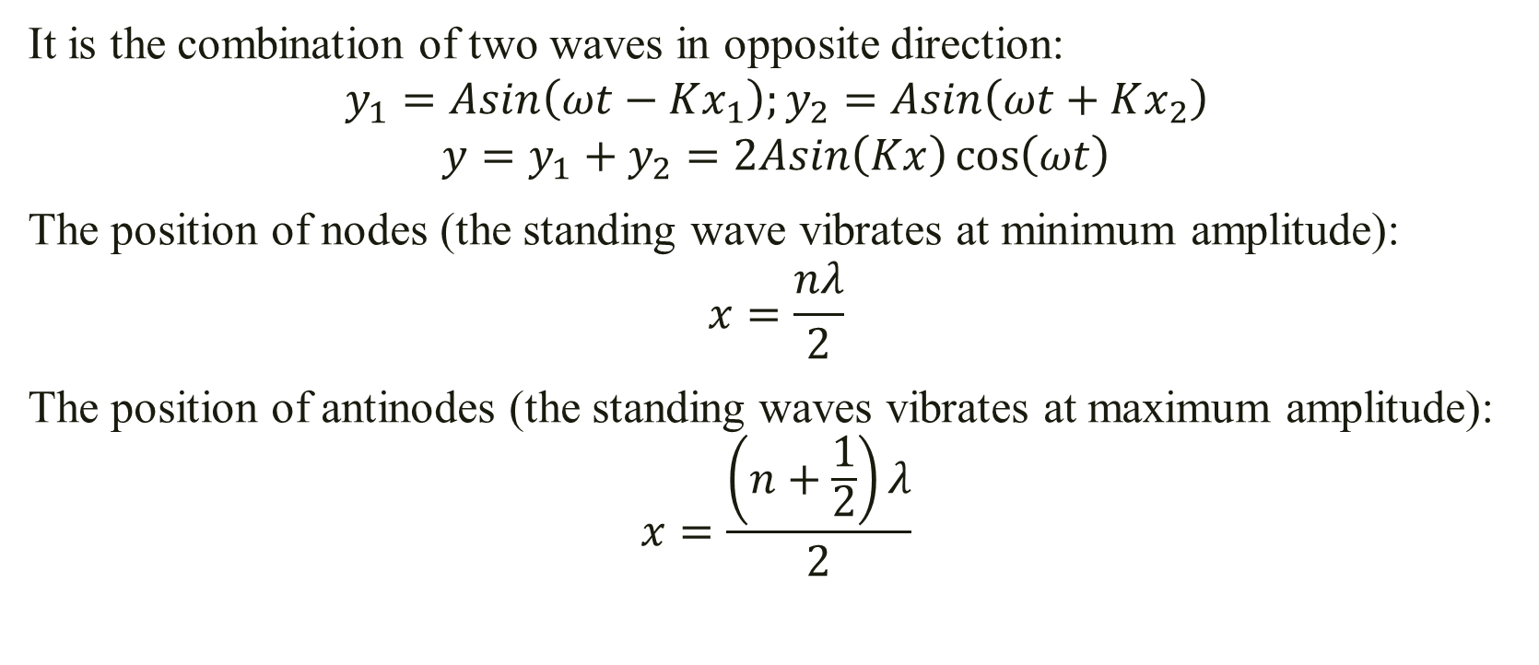
1.Mechanical Wave 1.4 Standing wave
It is the combination of two waves in opposite direction:
$$y_{1}=Asin\left(ωt−Kx_{1}\right);y_{2}=Asin\left(ωt+Kx_{2}\right)$$
$$y=y_{1}+y_{2}=2Asin\left(Kx\right)\cos\left(ωt\right)$$
The position of nodes (the standing wave vibrates at minimum amplitude):
$$x=\frac{nλ}{2}$$
The position of antinodes (the standing waves vibrates at maximum amplitude):
$$x=\frac{\left(n+\frac{1}{2}\right)λ}{2}$$

Slide 13
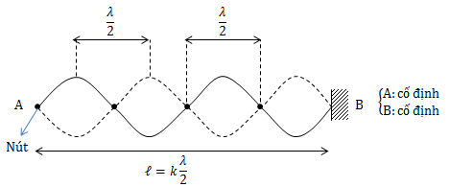
2.Mechanical Wave 2.4 Standing wave

Slide 14
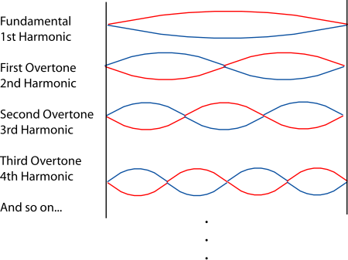
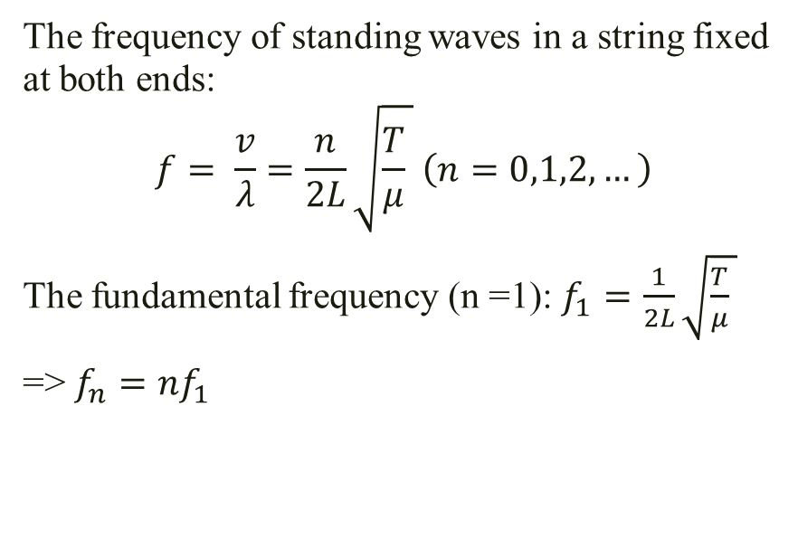
1.Mechanical Wave 1.4 Standing wave
The frequency of standing waves in a string fixed at both ends:
$$f= \frac{v}{λ}=\frac{n}{2L}\sqrt{\frac{T}{μ} } \left(n=0,1,2,…\right)$$
The fundamental frequency (n =1): $f_{1}=$ $\frac{1}{2L}\sqrt{\frac{T}{μ} }$
=> $f_{n}=nf_{1}$

Slide 15
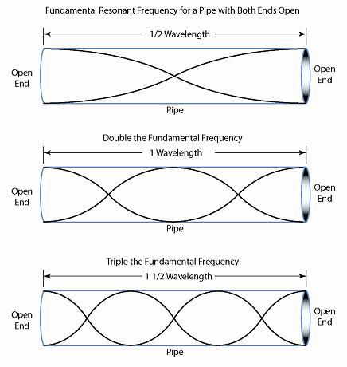
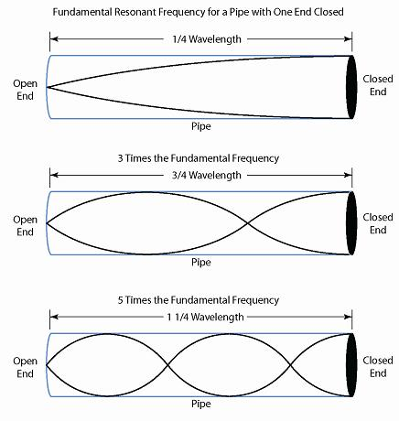
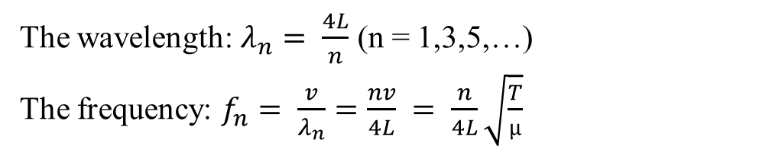
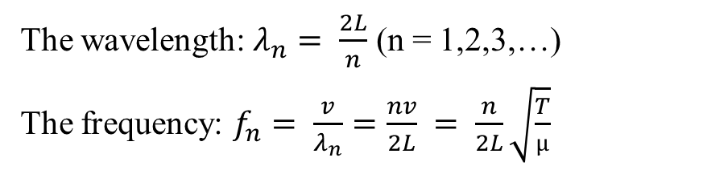
2.Mechanical Wave 2.4 Standing wave
The wavelength: $λ_{n}= \frac{2L}{n}$ (n = 1,2,3,…)
The frequency: $f_{n}= \frac{v}{λ_{n}}=\frac{nv}{2L} = \frac{n}{2L}\sqrt{\frac{T}{µ}}$
The wavelength: $λ_{n}= \frac{4L}{n}$ (n = 1,3,5,…)
The frequency: $f_{n}= \frac{v}{λ_{n}}=\frac{nv}{4L} = \frac{n}{4L}\sqrt{\frac{T}{µ}}$

Slide 16
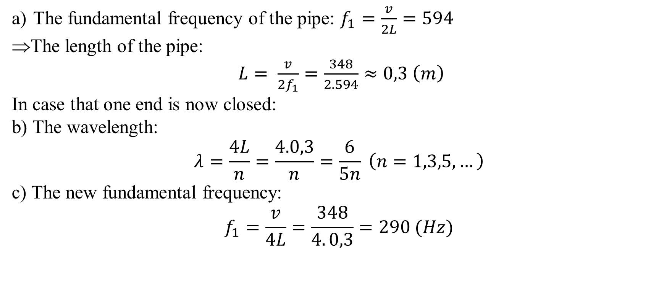
The fundmental frequency if a pipe that is opened at both ends is 594 Hz
a) How long is this pipe ?
If one end is now closed, find
b) The wavelength and
c) The frequency of the new fundamental
[June – 2013]
The fundamental frequency of the pipe: $f_{1}=\frac{v}{2L}=594$
The length of the pipe:
$L= \frac{v}{2f_{1}}=\frac{348}{2.594}≈0,3 \left(m\right)$
In case that one end is now closed:
b) The wavelength:
$$λ=\frac{4L}{n}=\frac{4.0,3}{n}=\frac{6}{5n} \left(n=1,3,5,…\right)$$
c) The new fundamental frequency:
$$f_{1}=\frac{v}{4L}=\frac{348}{4. 0,3}=290 (Hz)$$

Slide 17
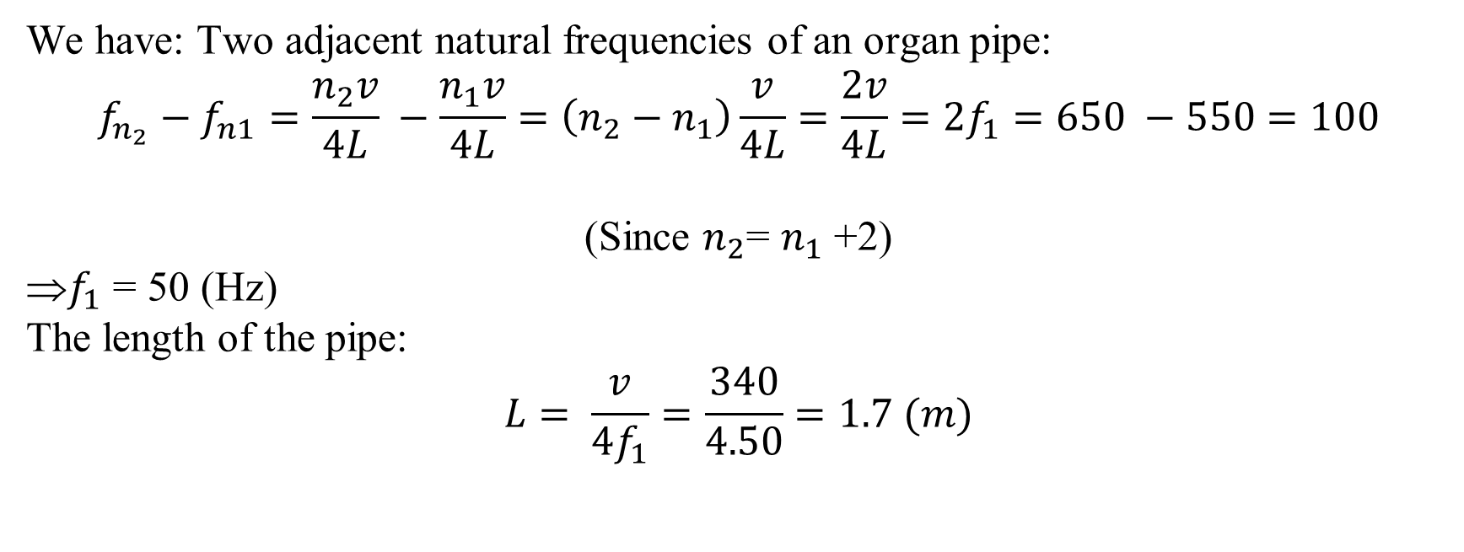
If two adjacent natural frequencies of an organ pipe are determined to be 550Hz and 650 Hz, calculate the fundamental frequency and the length of the pipe. The v = 340 m/s as the speed of the sound in air
[April – 2013]
We have: Two adjacent natural frequencies of an organ pipe:
$$f_{n_{2}}−f_{n1}=\frac{n_{2}v}{4L} −\frac{n_{1}v}{4L}=\left(n_{2}−n_{1}\right)\frac{v}{4L}=\frac{2v}{4L}=2f_{1}=650 −550=100$$
(Since $n_{2}$= $n_{1}$ +2)
$f_{1}$ = 50 (Hz)
The length of the pipe:
$$L= \frac{v}{4f_{1}}=\frac{340}{4.50}=1.7 (m)$$

Slide 18
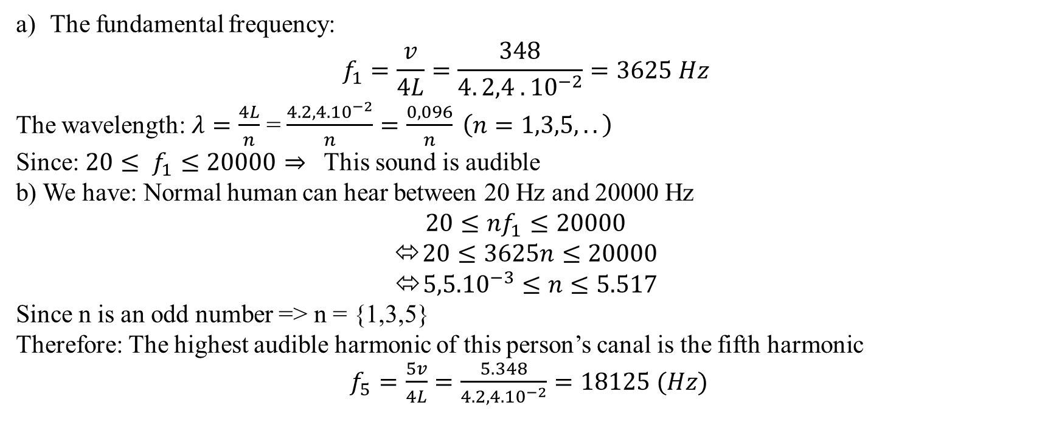
The auditory canal of the car is filled with air. One end is open, and the other end is closed by the eardrum. A particular person’s auditory canal is 2.40 cm long and can be modeled as a piped a) What are the fundamental frequency and the wavelength of this person’s auditory canal ? Is this sound audible ? b) Find the frequency of the highest audible harmonic of this person’s canal ? Which harmonic is this ?
[July – 2014]
The fundamental frequency:
$$f_{1}=\frac{v}{4L}=\frac{348}{4. 2,4 . {10}^{−2}}=3625 Hz$$
The wavelength: $λ=\frac{4L}{n}$ = $\frac{{4.2,4.10}^{−2}}{n}=\frac{0,096}{n} \left(n=1,3,5,..\right)$
Since: $20≤ f_{1}≤20000⇒$ This sound is audible
b) We have: Normal human can hear between 20 Hz and 20000 Hz
$$20≤nf_{1}≤20000$$
$20≤3625n≤20000$
${5,5.10}^{−3}≤n≤5.517$
Since n is an odd number => n = {1,3,5}
Therefore: The highest audible harmonic of this person’s canal is the fifth harmonic
$f_{5}=$ $\frac{5v}{4L}=\frac{5.348}{{4.2,4.10}^{−2}}=18125 (Hz)$

Slide 19
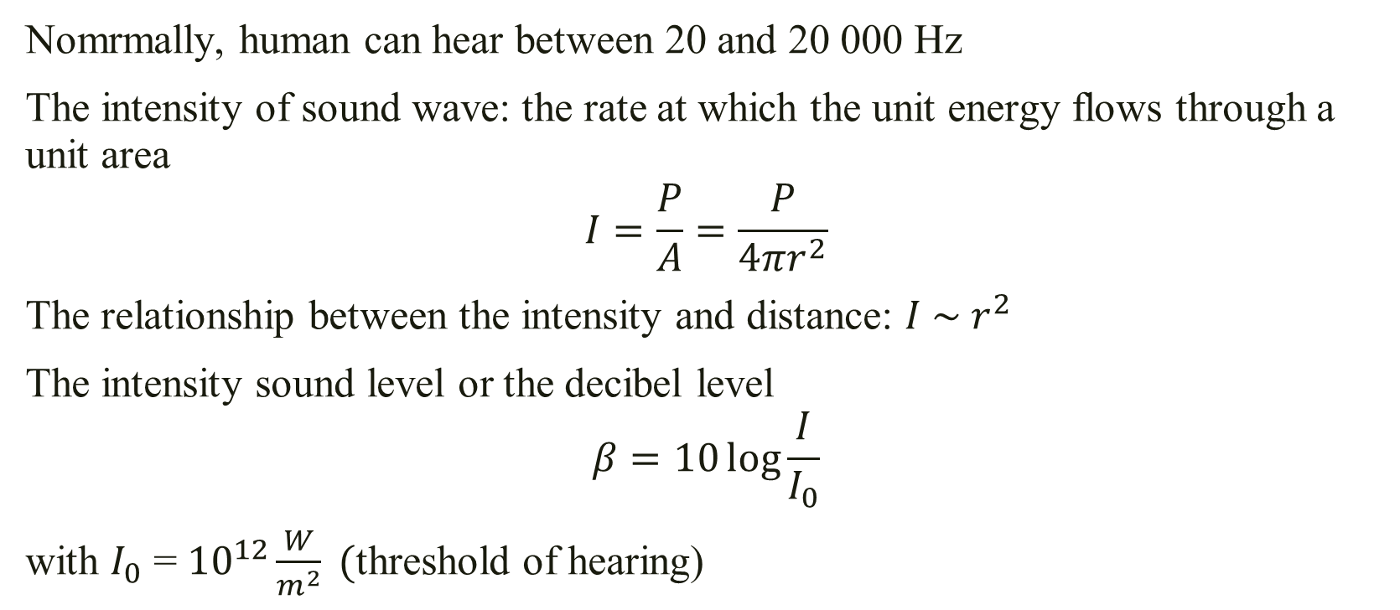
1.Mechanical Wave 1.5 Sound wave
Nomrmally, human can hear between 20 and 20 000 Hz
The intensity of sound wave: the rate at which the unit energy flows through a unit area
$$I=\frac{P}{A}=\frac{P}{4πr^{2}}$$
The relationship between the intensity and distance: $I \sim r^{2}$
The intensity sound level or the decibel level
$$β=10\log{\frac{I}{I_{0}}}$$
with $I_{0}$ = ${10}^{12}\frac{W}{m^{2}} ($threshold of hearing)

Slide 20
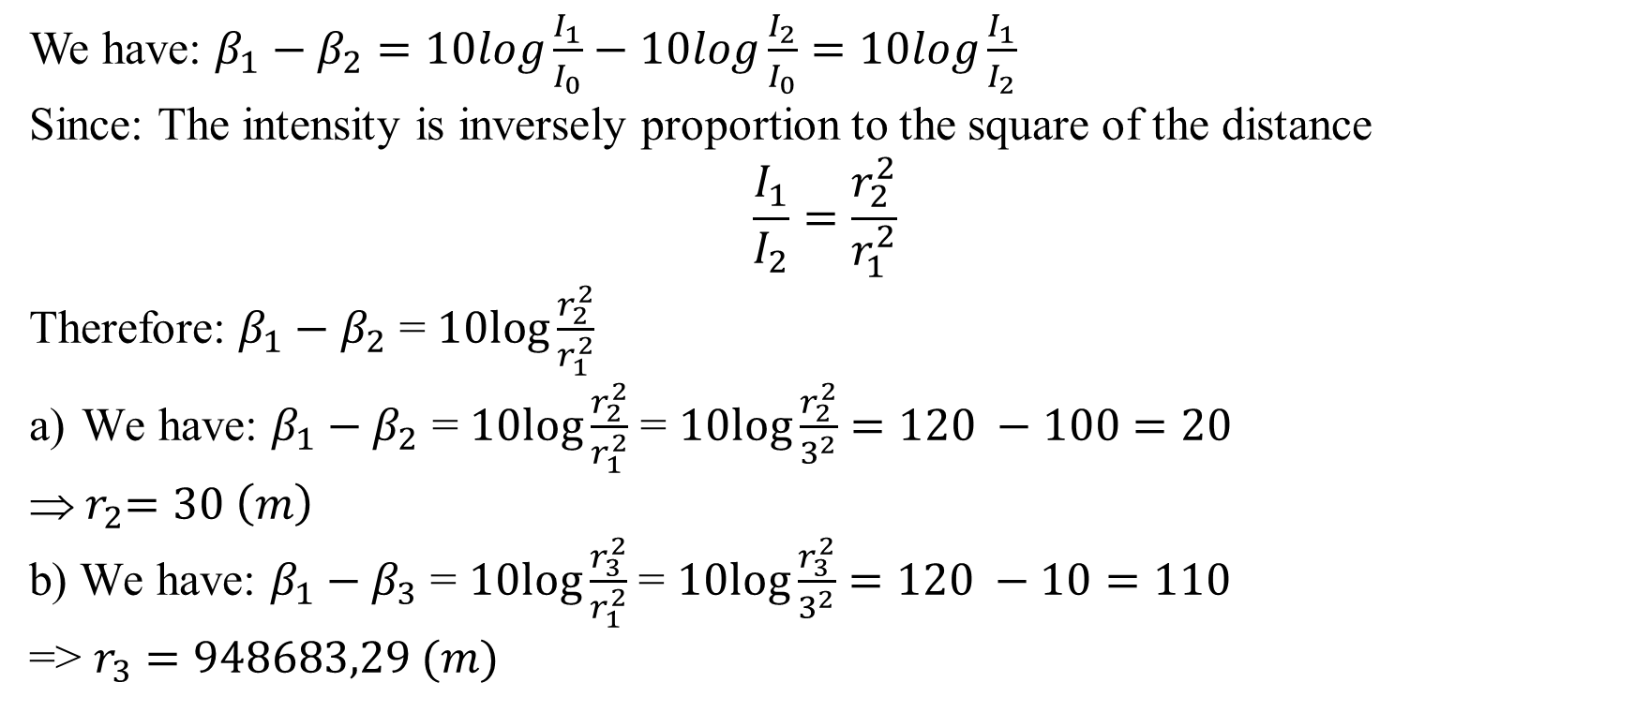
The sound level at a distance of 3.00 m from a source is 120 dB. At what distances is the sound level
(a) 100 dB and
(b) 10.0 dB?
[Extra Problem – Wave]
We have: $β_{1}−β_{2}=10log\frac{I_{1}}{I_{0}}−10log\frac{I_{2}}{I_{0}}=10log\frac{I_{1}}{I_{2}}$
Since: The intensity is inversely proportion to the square of the distance
$$\frac{I_{1}}{I_{2}}=\frac{r_{2}^{2}}{r_{1}^{2}}$$
Therefore: $β_{1}−β_{2}$ = $10log\frac{r_{2}^{2}}{r_{1}^{2}}$
We have: $β_{1}−β_{2}$ = $10log\frac{r_{2}^{2}}{r_{1}^{2}}$ = $10log\frac{r_{2}^{2}}{3^{2}}=120 −100=20$
${ r}_{2}=30 \left(m\right)$
b) We have: $β_{1}−β_{3}$ = $10log\frac{r_{3}^{2}}{r_{1}^{2}}$ = $10log\frac{r_{3}^{2}}{3^{2}}=120 −10=110$
=> $r_{3}=948683,29 (m)$

Slide 21
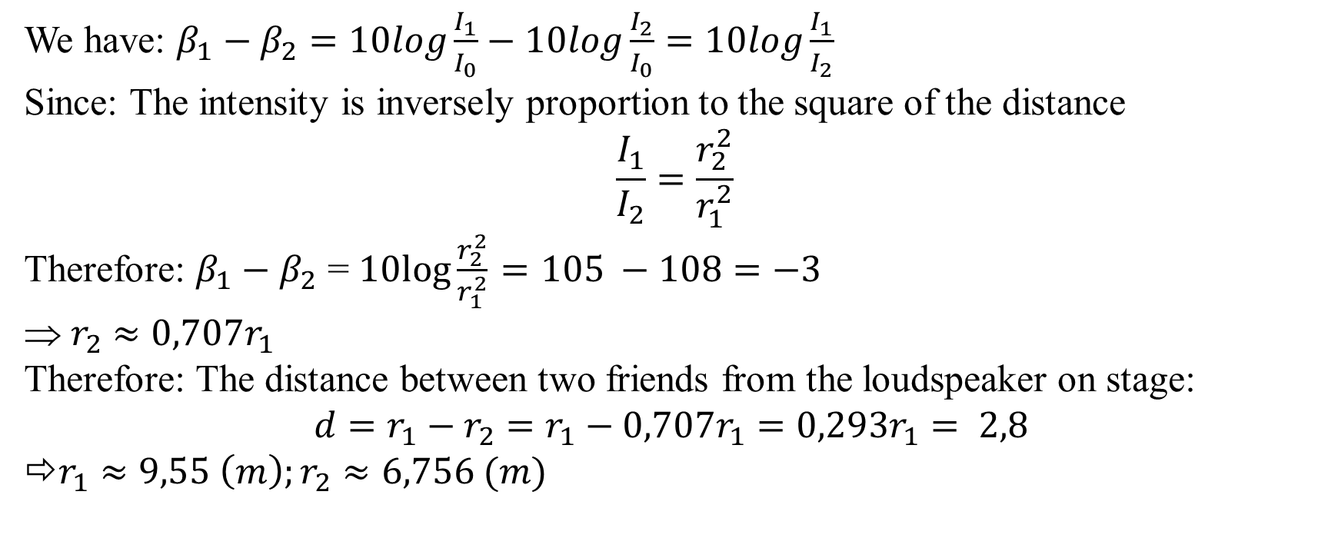
Two friends attend a rock concert and bring along a sound meter. With this device, one of the friends measures a sound level of 105 dB, whereas the other, who sits 2.8m closer to the stage, measures 108 dB. How far are the two friends from the loudspeaker on stage ?
[April – 2018]
We have: $β_{1}−β_{2}=10log\frac{I_{1}}{I_{0}}−10log\frac{I_{2}}{I_{0}}=10log\frac{I_{1}}{I_{2}}$
Since: The intensity is inversely proportion to the square of the distance
$$\frac{I_{1}}{I_{2}}=\frac{r_{2}^{2}}{r_{1}^{2}}$$
Therefore: $β_{1}−β_{2}$ = $10log\frac{r_{2}^{2}}{r_{1}^{2}}$ $=105 −108=−3$
$r_{2}$ $≈0,707r_{1}$
Therefore: The distance between two friends from the loudspeaker on stage:
$$d=r_{1}−r_{2}=r_{1}−0,707r_{1}=0,293r_{1}= 2,8$$
⇨$r_{1}≈9,55 \left(m\right);r_{2}≈6,756 (m)$

Slide 22
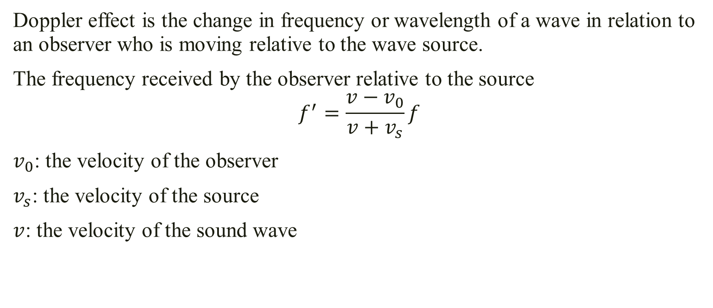
1.Mechanical Wave 1.6 Doppler effect
Doppler effect is the change in frequency or wavelength of a wave in relation to an observer who is moving relative to the wave source.
The frequency received by the observer relative to the source
$$f^{′}=\frac{v−v_{0}}{v+v_{s}}f$$
$v_{0}$: the velocity of the observer
$v_{s}$: the velocity of the source
$v$: the velocity of the sound wave

Slide 23
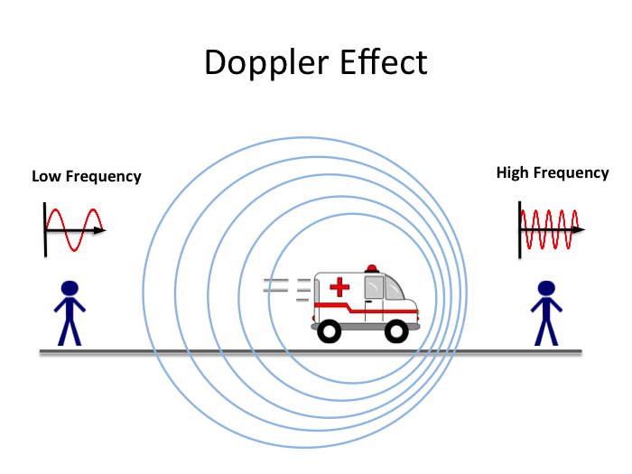
2.Mechanical Wave 2.6 Doppler effect

Slide 24

While standing near a railroad crossing, a person hears a distant train horn. The frequency emitted by the horn is 440 Hz. The train is traveling at 20 m/s and the speed of sound is 348 m/s.
a) The adjusted frequency that reaches the bystander as the train approaches the crossing
b) The adjusted frequency that reaches the bystander once the train has passed the crossing
[July – 2017]
According to the Doppler effect, when the train approaches the crossing
$$f^{′}=\frac{v}{v−v_{s}}f= \frac{348}{348−20}. 440=466,82 \left(Hz\right)$$
b) According to the Doppler effect, when the train has passed the crossing
$$f^{′}=\frac{v}{v+v_{s}}f=\frac{348}{348+20 }.440=416,08 (Hz)$$

Slide 25
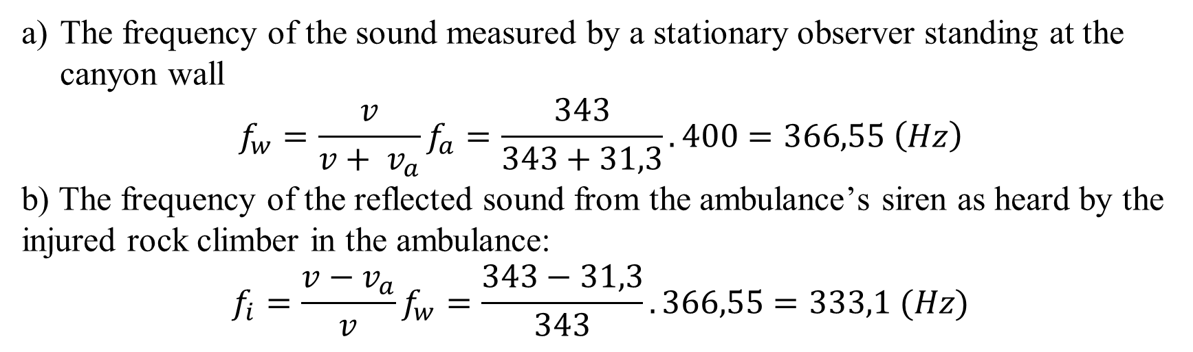
An ambulance has picked up an injured rock climber and is heading directly away from the canyon wall (where the climber was injured) at a speed of 31.3 m/s. The ambulance’s siren has a frequency of 400 Hz. After the ambulance turns off the siren, the injured rock climber can hear the reflected sound from the canyon wall for a few seconds. The velocity of sound in air is 343 m/s.
What is the frequency of the sound measured by a stationary observer standing at the canyon wall?
What is the frequency of the reflected sound from the ambulance’s siren as heard by the injured rock climber in the ambulance
[April – 2018]
The frequency of the sound measured by a stationary observer standing at the canyon wall
$$f_{w}=\frac{v}{v+ v_{a}}f_{a}=\frac{343}{343+31,3}. 400=366,55 \left(Hz\right)$$
b) The frequency of the reflected sound from the ambulance’s siren as heard by the injured rock climber in the ambulance:
$$f_{i}=\frac{v−v_{a}}{v}f_{w}=\frac{343−31,3}{343}.366,55=333,1 (Hz)$$

Slide 26
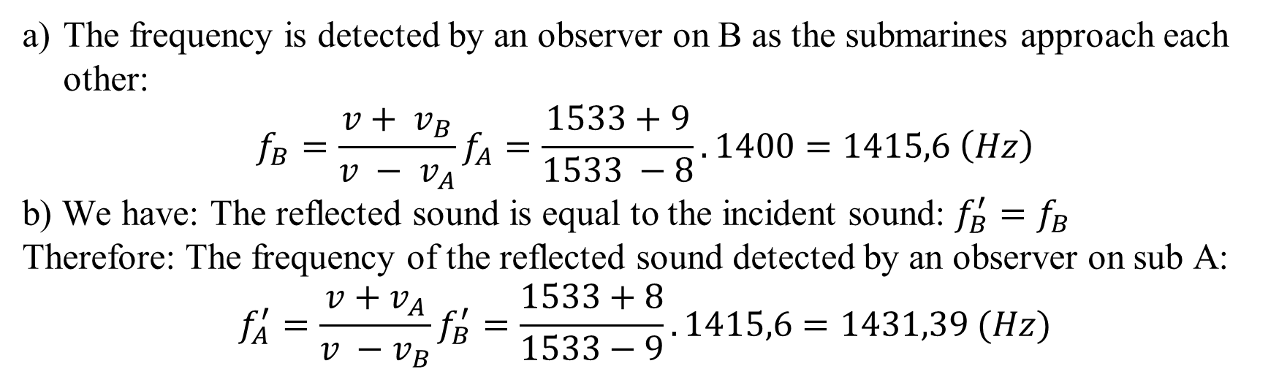
A submarine A travels through water at a speed of 8 m/s, emitting a sonar wave at a frequency of 1400 Hz. The speed of sound in the water is 1533 m/s. A second submarine is moving toward A at 9 m/s
What frequency is detected by an observer on B as the submarines approach each other ?
While the submarines approach each other, some of the sound from A reflects from B and returns to A. If this sound were to be detected by an observer on sub A, what is its frequency ?
[November – 2018]
The frequency is detected by an observer on B as the submarines approach each other:
$$f_{B}=\frac{v+ v_{B}}{v − v_{A}}f_{A}=\frac{1533+9}{1533 −8}.1400=1415,6 \left(Hz\right)$$
b) We have: The reflected sound is equal to the incident sound: $f_{B}^{′}=f_{B}$
Therefore: The frequency of the reflected sound detected by an observer on sub A:
$$f_{A}^{′}=\frac{v+v_{A}}{v −v_{B}}f_{B}^{′}=\frac{1533+8}{1533−9}.1415,6=1431,39 (Hz)$$

Slide 27
Chapter 2: LIGHT

Slide 28
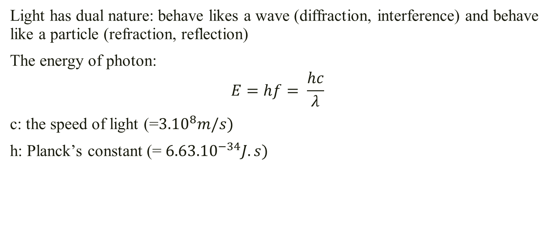
1. The nature of light
Light has dual nature: behave likes a wave (diffraction, interference) and behave like a particle (refraction, reflection)
The energy of photon:
$$E=hf= \frac{hc}{λ}$$
c: the speed of light (=${3.10}^{8}m/s)$
h: Planck’s constant (= ${6.63.10}^{−34}J.s)$

Slide 29
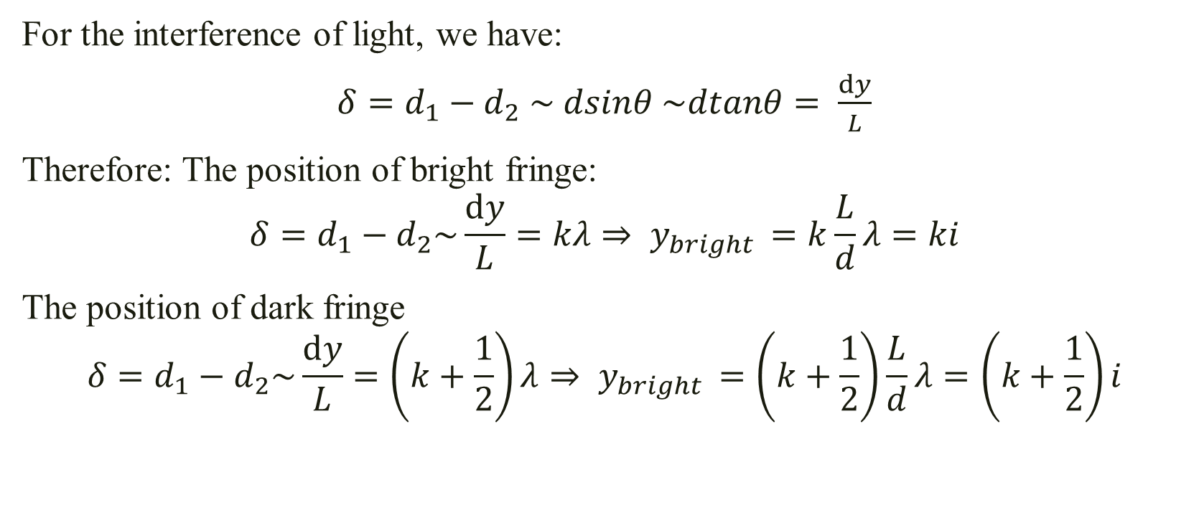
2. Interference 2.1 Interference of light (Young’s experiment)
For the interference of light, we have:
$δ=d_{1}−d_{2}$ $\sim dsinθ \sim dtanθ= \frac{ⅆy}{L}$
Therefore: The position of bright fringe:
$$δ=d_{1}−d_{2}\sim \frac{ⅆy}{L}=kλ⇒ y_{bright }=k\frac{L}{d}λ=ki$$
The position of dark fringe
$$δ=d_{1}−d_{2}\sim \frac{ⅆy}{L}=\left(k+\frac{1}{2}\right)λ⇒ y_{bright }=\left(k+\frac{1}{2}\right)\frac{L}{d}λ=\left(k+\frac{1}{2}\right)i$$

Slide 30
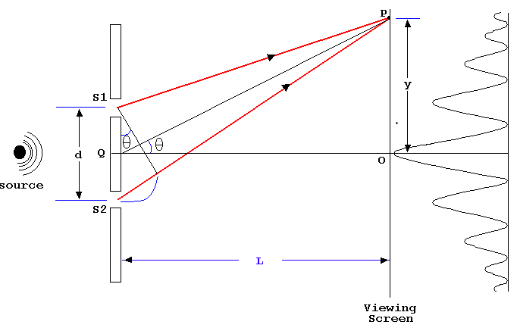
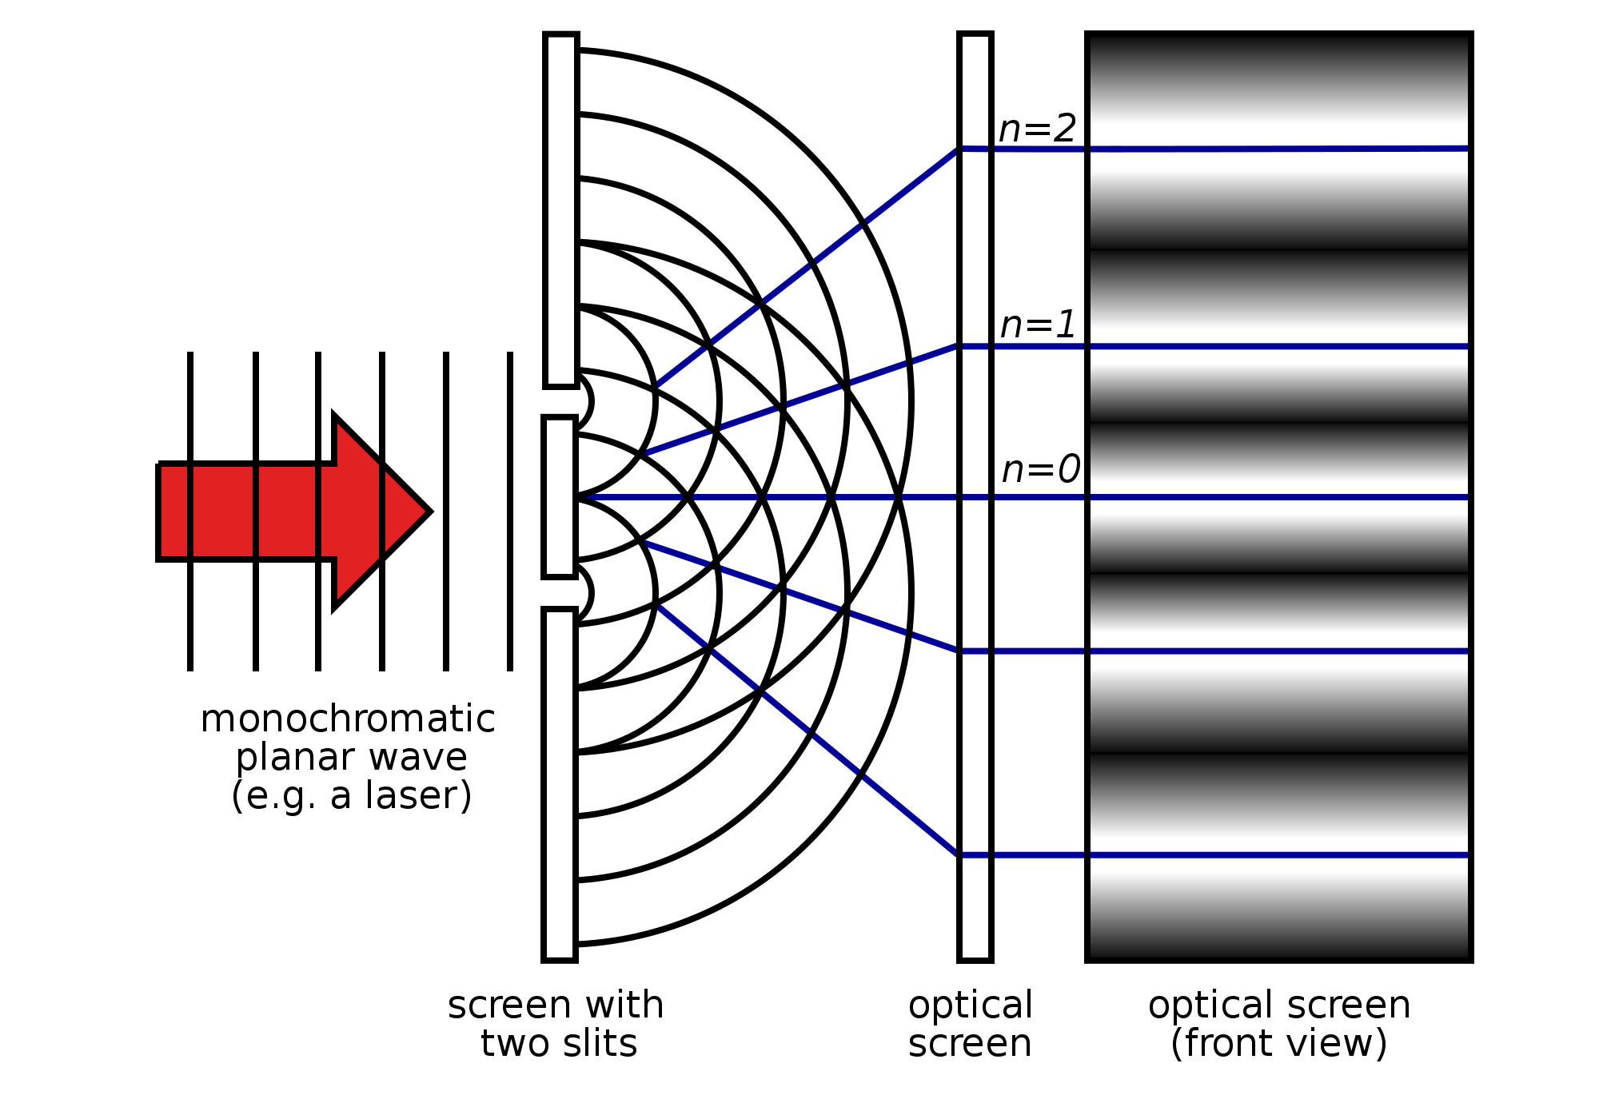
2. Interference 2.1 Interference of light (Young’s experiment)

Slide 31
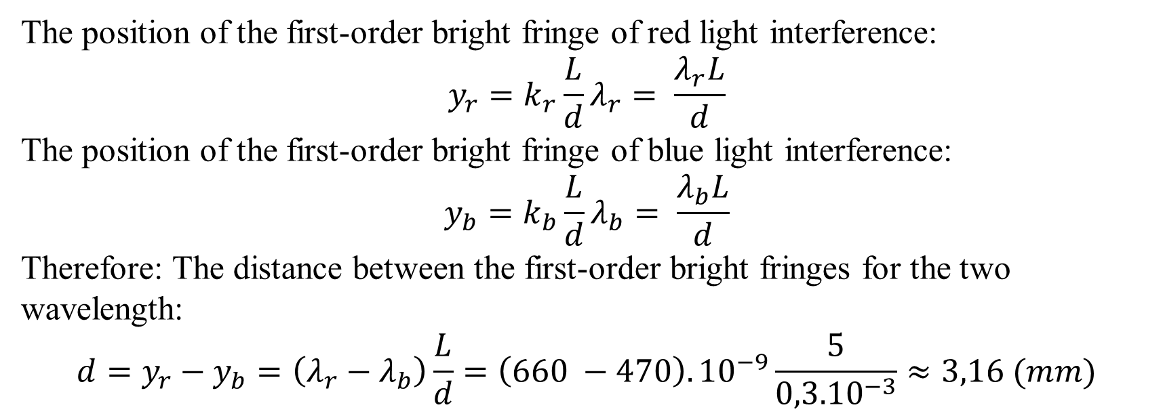
Coherent light contains two wavelengths, 660 nm (red) and 470 nm (blue), passes through two narrow slits separated by 0.3 mm, and the interference pattern is observed on a screen 5m from the slits. What is the distance on the screen between the first-order bright fringes for the two wavelengths ?
[June – 2013]
The position of the first-order bright fringe of red light interference:
$$y_{r}=k_{r}\frac{L}{d}λ_{r}= \frac{λ_{r}L}{d}$$
The position of the first-order bright fringe of blue light interference:
$$y_{b}=k_{b}\frac{L}{d}λ_{b}= \frac{λ_{b}L}{d}$$
Therefore: The distance between the first-order bright fringes for the two wavelength:
$$d=y_{r}−y_{b}=\left(λ_{r}−λ_{b}\right)\frac{L}{d}=\left(660 −470\right).{10}^{−9}\frac{5}{{0,3.10}^{−3}}≈3,16 (mm)$$

Slide 32
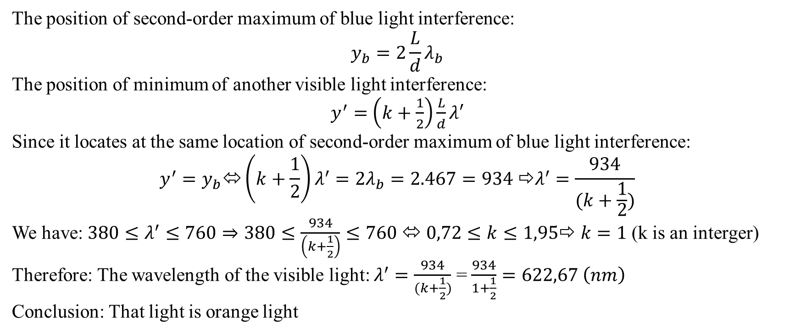
In a Young’s double slit experiment, it is found that blue light of wavelength 467 nm gives a second-order maximum at a certain location on the screen. What wavelength of visible light would have a minimum at the same location ? What is the color of those lights ?
[July – 2017]
The position of second-order maximum of blue light interference:
$$y_{b}=2\frac{L}{d}λ_{b}$$
The position of minimum of another visible light interference:
$y^{′}=$ $\left(k+\frac{1}{2}\right)\frac{L}{d}λ′$
Since it locates at the same location of second-order maximum of blue light interference:
$$y^{′}=y_{b}⬄\left(k+\frac{1}{2}\right)λ^{′}=2λ_{b}=2.467=934 ⇨λ^{′}=\frac{934}{(k+\frac{1}{2})}$$
We have: $380≤λ^{′}≤760⇒380≤\frac{934}{\left(k+\frac{1}{2}\right)}≤760 ⬄ 0,72≤k≤1,95$⇨ $k=1$(k is an interger)
Therefore: The wavelength of the visible light: $λ^{′}=\frac{934}{(k+\frac{1}{2})}$ = $\frac{934}{1+\frac{1}{2}}=622,67 \left(nm\right)$
Conclusion: That light is orange light

Slide 33
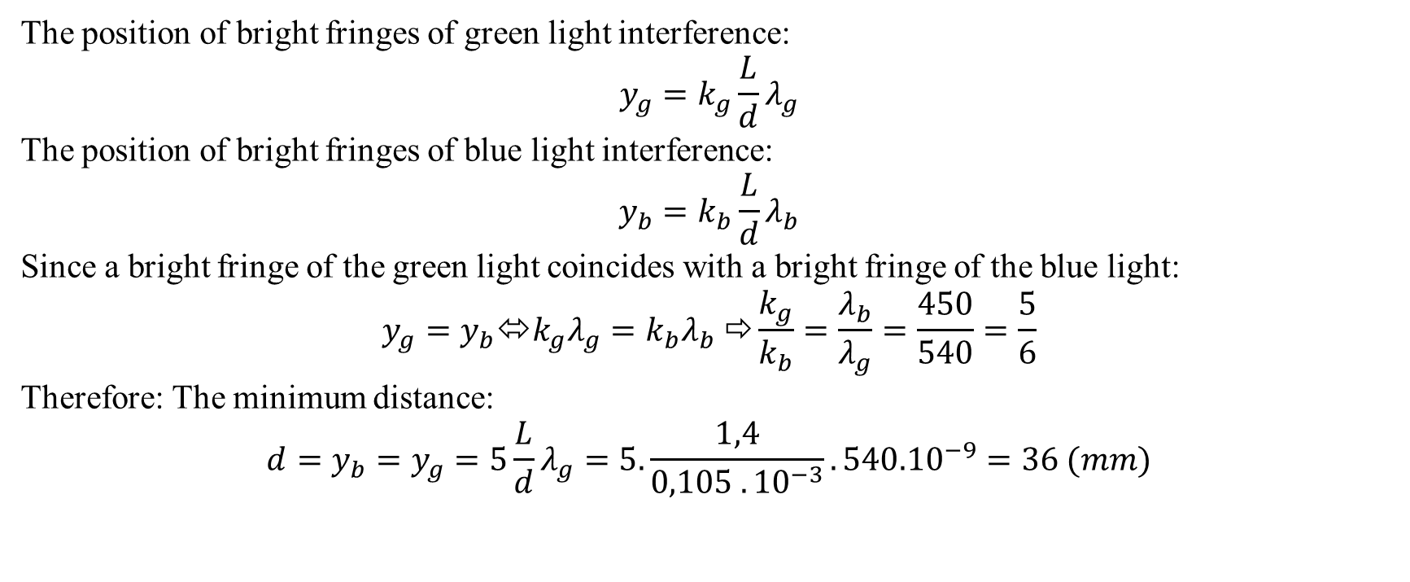
In a Young’s interference experiment, the two slits are separated by 0.105 mm and the incident light includes two wavelengths: 540 nm (green) and 450 nm (blue). The overlapping interference pattern are observed on a screen 1.4m from the slits.
Calculate the minimum distance from the center of the screen to a point when a bright fringe of the green light coincides with a bright fringe of the blue light
[November – 2018]
The position of bright fringes of green light interference:
$$y_{g}=k_{g}\frac{L}{d}λ_{g}$$
The position of bright fringes of blue light interference:
$$y_{b}=k_{b}\frac{L}{d}λ_{b}$$
Since a bright fringe of the green light coincides with a bright fringe of the blue light:
$$y_{g}=y_{b}⬄k_{g}λ_{g}=k_{b}λ_{b} ⇨\frac{k_{g}}{k_{b}}=\frac{λ_{b}}{λ_{g}}=\frac{450}{540}=\frac{5}{6}$$
Therefore: The minimum distance:
$$d=y_{b}=y_{g}=5\frac{L}{d}λ_{g}=5.\frac{1,4}{0,105 . {10}^{−3}}.{540.10}^{−9}=36 (mm)$$

Slide 34
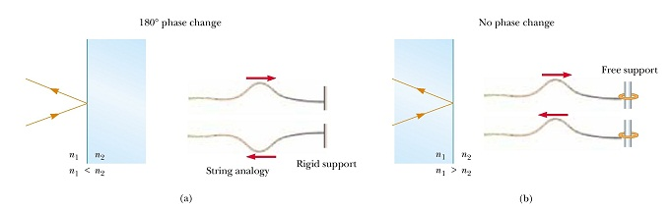
2. Interference 2.2 Thin film interference
Change of phase due to reflection:

Slide 35
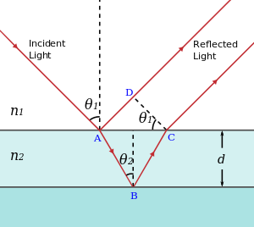
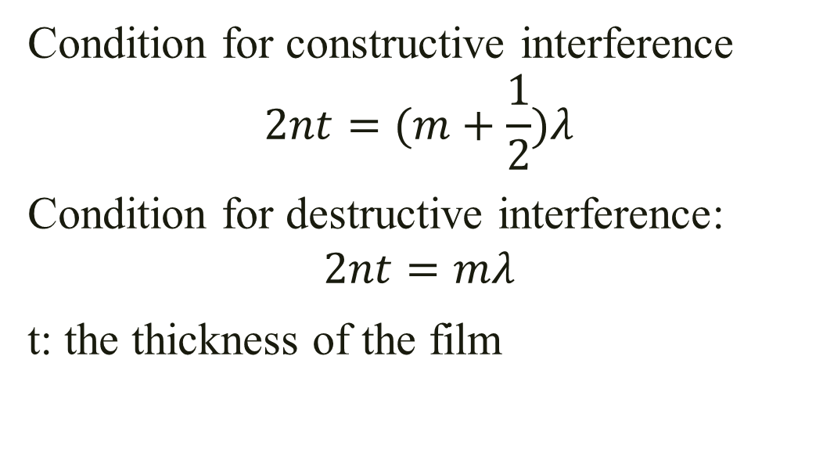
2. Interference 2.2 Thin film interference
Condition for constructive interference
$$2nt=(m+\frac{1}{2})λ$$
Condition for destructive interference:
$$2nt=mλ$$
t: the thickness of the film

Slide 36
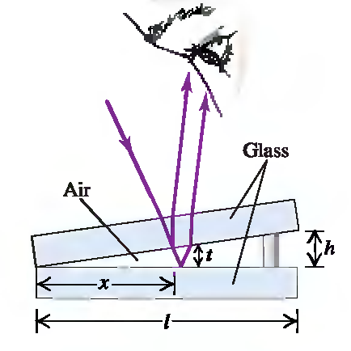
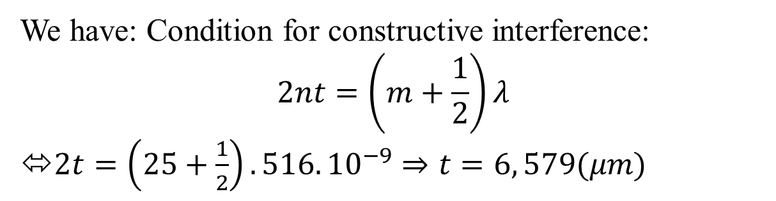
Light of the wavelength 516 nm is incident perpendicularly on two glass plates. The glass plates are spaced at one end by a thin piece of Kapton film. Due to the wedge of air created by this film, 25 bright interference fringes are observed across the top plate, with a dark fringe at the end by the film.
How thick is the film ?
[April – 2018]
We have: Condition for constructive interference:
$$2nt=\left(m+\frac{1}{2}\right)λ$$
⬄$2t=\left(25+\frac{1}{2}\right).516. {10}^{−9}⇒t=6, 579(μm)$

Slide 37
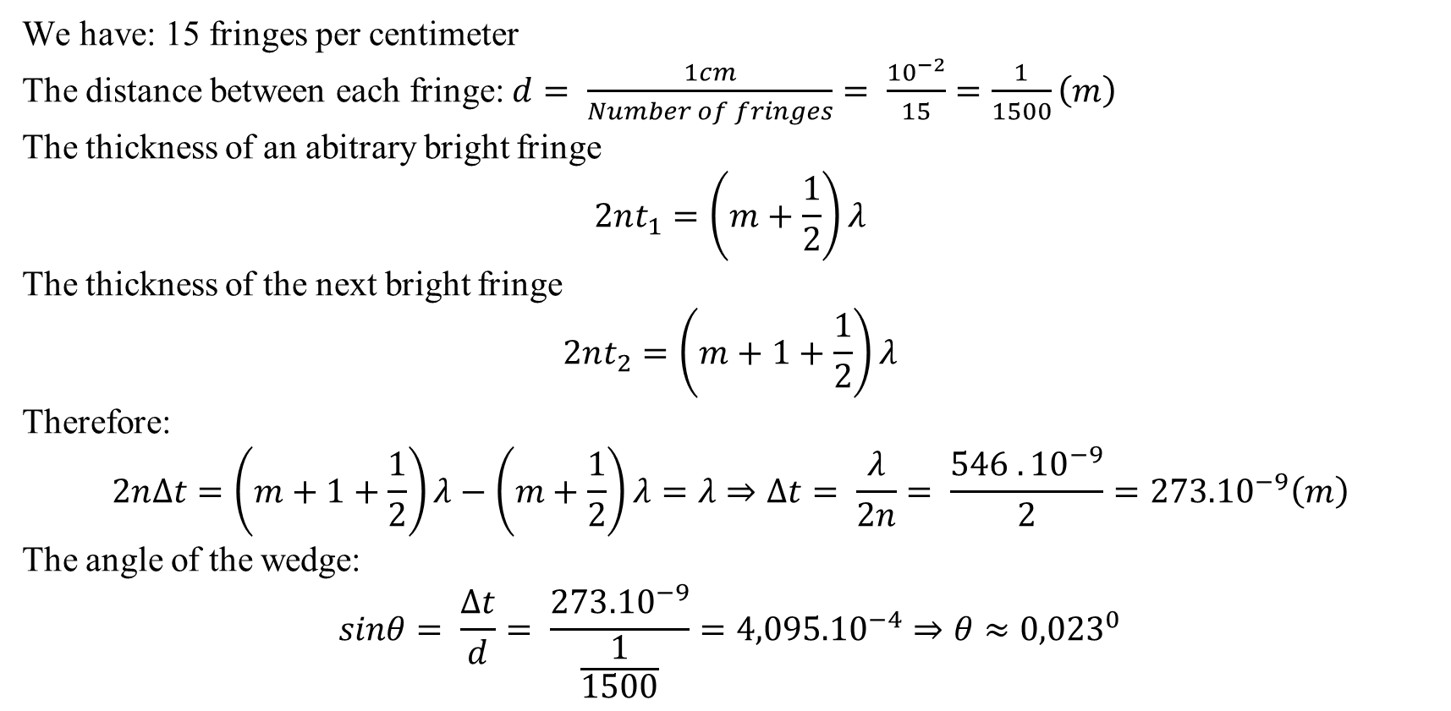
Two rectangular pieces of plane glass are laid one upon the other on a table. A thin strip of paper is placed between them at one edge so that a very thin wedge of air is formed. The plates are illuminated at normal incidence by 546 nm light from a mercury-vapor lamp. Interference fringes are formed, with 15 fringes per centimeter. Find the angle of the wedge.
[July – 2017]
We have: 15 fringes per centimeter
The distance between each fringe: $d= \frac{1cm}{Number of fringes}= \frac{{10}^{−2}}{15}=\frac{1}{1500}\left(m\right)$
The thickness of an abitrary bright fringe
$$2nt_{1}=\left(m+\frac{1}{2}\right)λ$$
The thickness of the next bright fringe
$$2nt_{2}=\left(m+1+\frac{1}{2}\right)λ$$
Therefore:
$$2n∆t=\left(m+1+\frac{1}{2}\right)λ−\left(m+\frac{1}{2}\right)λ=λ⇒∆t= \frac{λ}{2n}= \frac{546 . {10}^{−9}}{2}={273.10}^{−9}\left(m\right)$$
The angle of the wedge:
$$sinθ= \frac{∆t}{d}= \frac{{273.10}^{−9}}{\frac{1}{1500}}={4,095.10}^{−4}⇒θ≈{0,023}^{0}$$

Slide 38
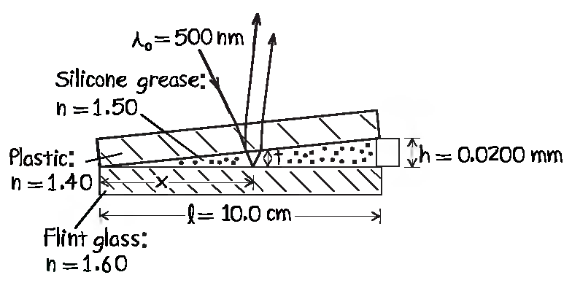
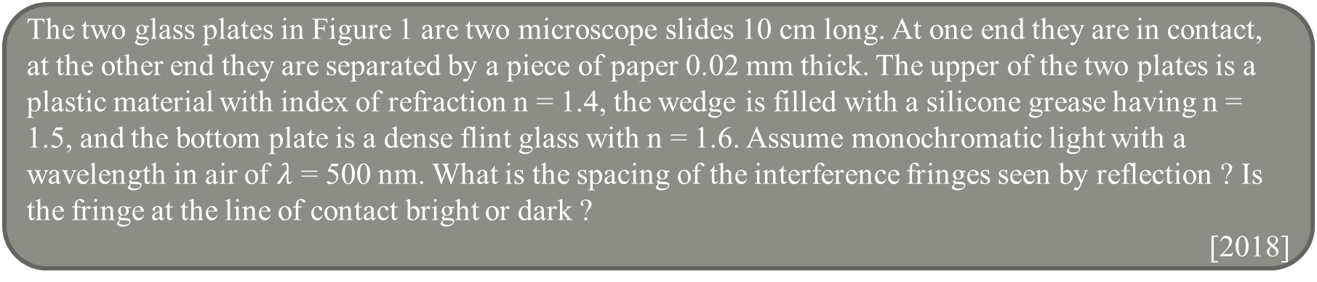
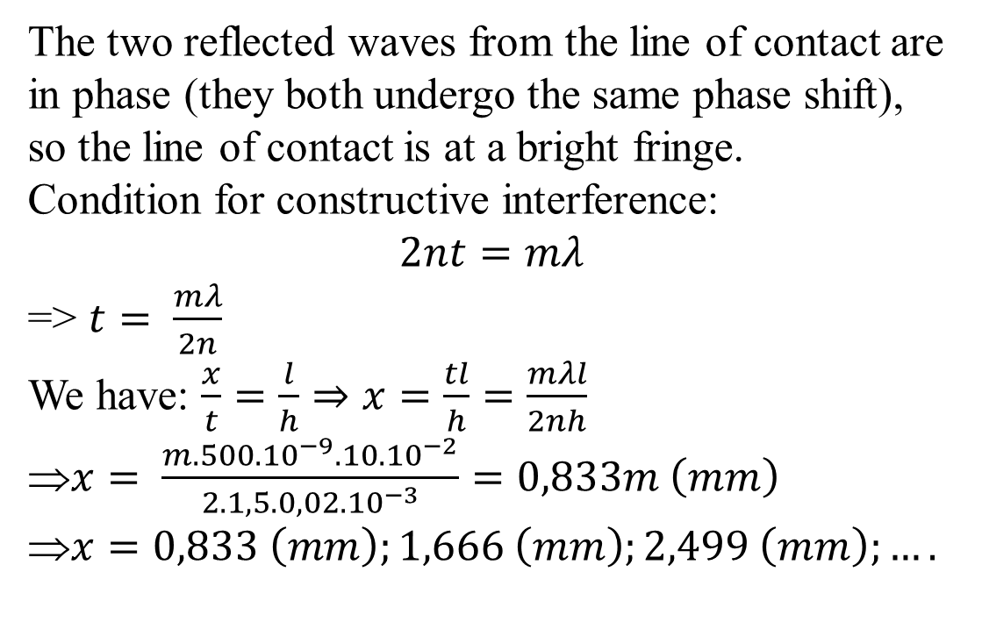
The two glass plates in Figure 1 are two microscope slides 10 cm long. At one end they are in contact, at the other end they are separated by a piece of paper 0.02 mm thick. The upper of the two plates is a plastic material with index of refraction n = 1.4, the wedge is filled with a silicone grease having n = 1.5, and the bottom plate is a dense flint glass with n = 1.6. Assume monochromatic light with a wavelength in air of $λ$ = 500 nm. What is the spacing of the interference fringes seen by reflection ? Is the fringe at the line of contact bright or dark ?
[2018]
The two reflected waves from the line of contact are in phase (they both undergo the same phase shift), so the line of contact is at a bright fringe.
Condition for constructive interference:
$$2nt=mλ$$
=> $t= \frac{mλ}{2n}$
We have: $\frac{x}{t}=\frac{l}{h}⇒x=\frac{tl}{h}=\frac{mλl}{2nh}$
$x= \frac{m.{500.10}^{−9}.{10.10}^{−2}}{{2.1,5.0,02.10}^{−3}}=0,833m \left(mm\right)$
$x=0,833 \left(mm\right);1,666 \left(mm\right);2,499 \left(mm\right);….$

Slide 39
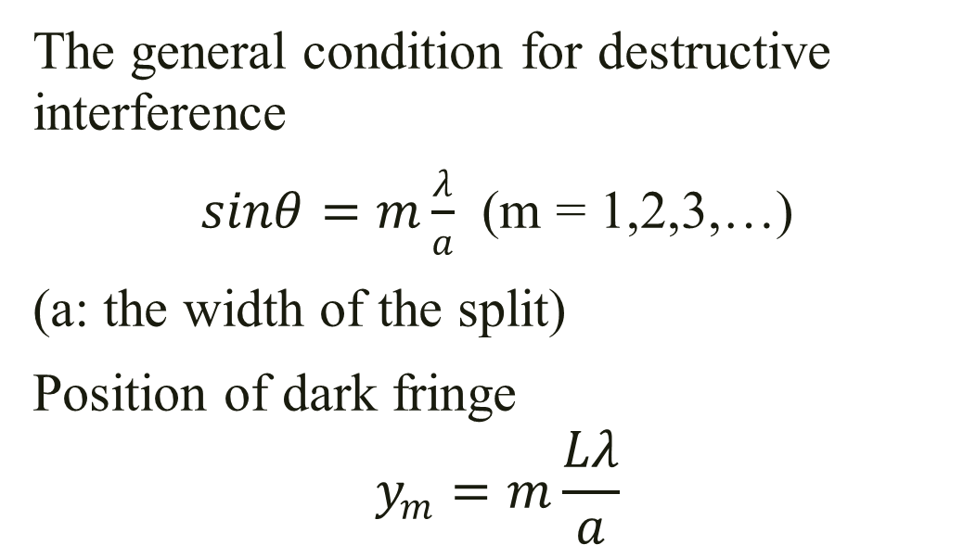
3. Diffraction 3.1 Single-slit diffraction
The general condition for destructive interference
$sinθ=m\frac{λ}{a}$ (m = 1,2,3,…)
(a: the width of the split)
Position of dark fringe
$$y_{m}=m\frac{Lλ}{a}$$

Slide 40
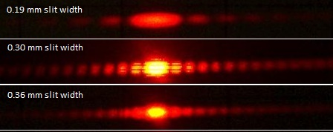
3. Diffraction 3.1 Single-slit diffraction

Slide 41
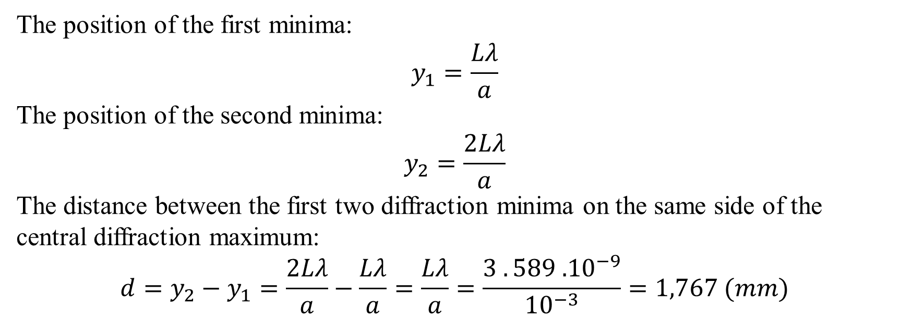
A slit 1.00 mm wide is illuminated by light of wavelength 589 nm. We see a diffraction pattern on a
screen 3.00 m away. What is the distance between the first two diffraction minima on the same side of
the central diffraction maximum?
[Extra Problem – Light]
The position of the first minima:
$$y_{1}=\frac{Lλ}{a}$$
The position of the second minima:
$$y_{2}=\frac{2Lλ}{a}$$
The distance between the first two diffraction minima on the same side of the central diffraction maximum:
$$d=y_{2}−y_{1}=\frac{2Lλ}{a}−\frac{Lλ}{a}=\frac{Lλ}{a}=\frac{3 . 589 {.10}^{−9}}{{10}^{−3}}=1,767 (mm)$$

Slide 42
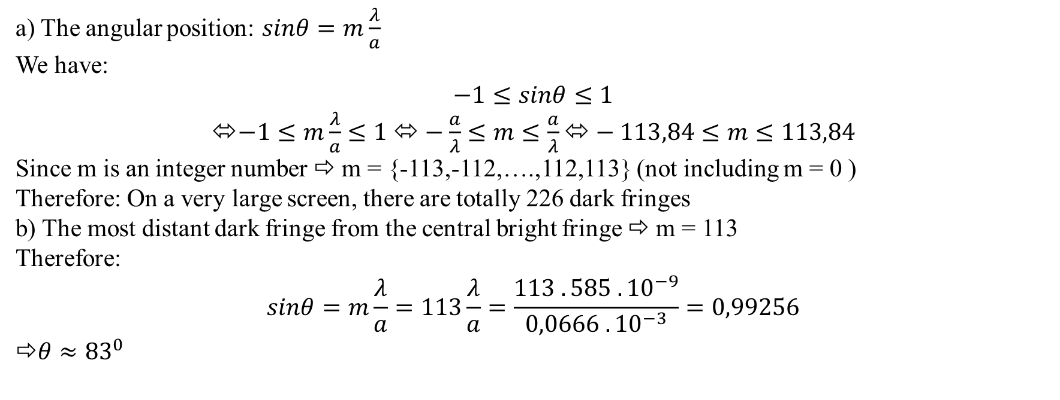
Light of wavelength 585 nm falls on a slit 0.0666 mm wide
On a very large distant screen, how many totally dark fringes will there be, including both sides of the central bright spot ?
At what angle will the dark fringe that is the most distant from the central bright fringe occur ?
[June – 2013]
a) The angular position: $sinθ=m\frac{λ}{a}$
We have:
$$−1≤sinθ≤1$$
⬄$−1≤m\frac{λ}{a}≤1 ⬄−\frac{a}{λ}≤m≤\frac{a}{λ}⬄−113,84≤m≤113,84$
Since m is an integer number ⇨ m = {-113,-112,….,112,113} (not including m = 0 )
Therefore: On a very large screen, there are totally 226 dark fringes
b) The most distant dark fringe from the central bright fringe ⇨ m = 113
Therefore:
$$sinθ=m\frac{λ}{a}=113\frac{λ}{a}=\frac{113 . 585 . {10}^{−9}}{0,0666 . {10}^{−3}}=0,99256$$
⇨$θ≈{83}^{0}$

Slide 43
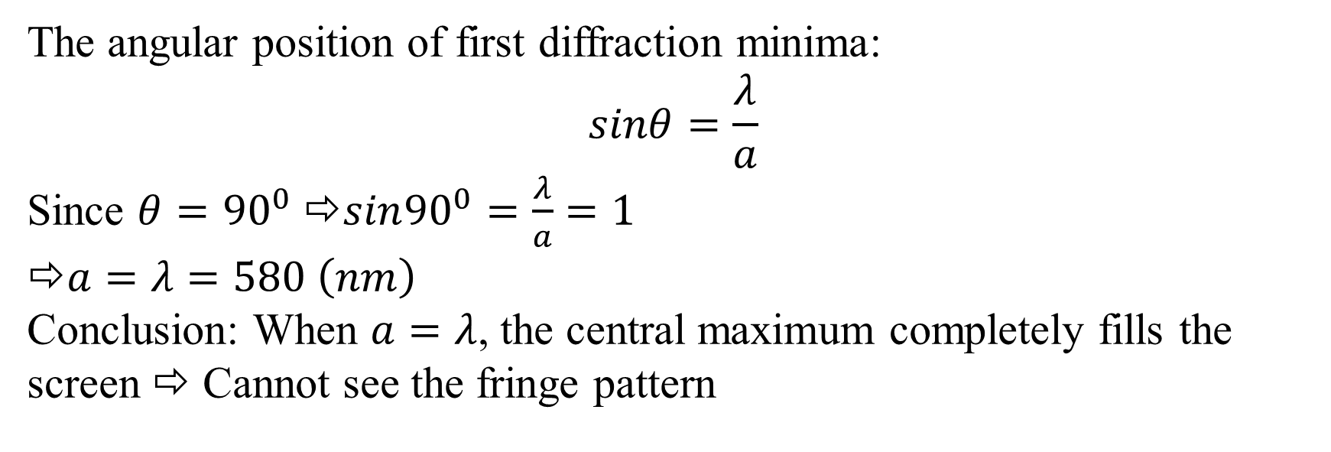
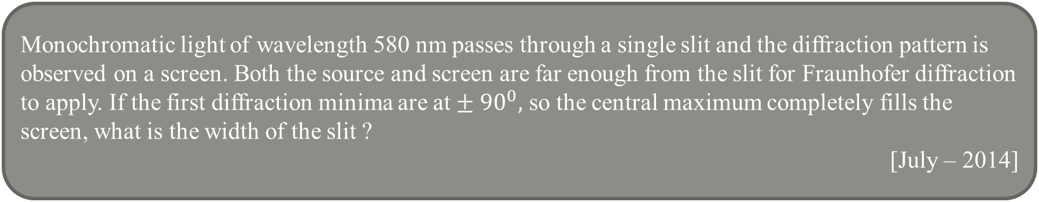
Monochromatic light of wavelength 580 nm passes through a single slit and the diffraction pattern is observed on a screen. Both the source and screen are far enough from the slit for Fraunhofer diffraction to apply. If the first diffraction minima are at $± 90^{0},$ so the central maximum completely fills the screen, what is the width of the slit ?
[July – 2014]
The angular position of first diffraction minima:
$$sinθ=\frac{λ}{a}$$
Since $θ=$ ${90}^{0} ⇨sin{90}^{0}=\frac{λ}{a}=1$
$a=λ=580 \left(nm\right)$
Conclusion: When $a=λ$, the central maximum completely fills the screen ⇨ Cannot see the fringe pattern

Slide 44

3. Diffraction 3.2 Diffraction grating
Consider a large number of splits, all with the same width a and spaced equal distances d between centers
The condition for maximum intensity:
$dsinθ=mλ$ (m =1,2,3,…)
(d: grating spacing)

Slide 45

A beam of light of wavelength 541 nm is incident on a diffraction grating that has 400 grooves/mm
Determine the angle of the second-order ray
If the entire apparatus is immersed in water, what is the new second-order angle of diffraction ?
[April – 2018]
The grating spacing: $d= \frac{1mm}{Number of grooves}=\frac{{10}^{−3}}{400}=2,5\left(μm\right)$
The second-order angle of diffraction :
$$dsinθ=2λ ⬄2,5 . {10}^{−6}sinθ=2 . {541.10}^{−9}⇒sinθ=0,4328$$
$θ≈{25,64}^{0}$
b) When the entire apparatus is immersed in water:
The wavelength:$λ^{′}=\frac{λ}{n}=\frac{541 . {10}^{−9}}{1,3333}=405,75 \left(nm\right)$
The new second-order angle of diffraction:
$$dsinθ^{′}=2λ^{′}⬄2,5 . {10}^{−6}sinθ^{′}=2 . {405,75.10}^{−9}⇒sinθ^{′}=0,3246$$
⇨ $θ′≈{18,94}^{0}$

Slide 46

Light from an argon laser strikes a diffraction grating that has 5310 grooves per centimeter. The central and first order principal maxima are separated by 0.488 m on a wall 1.72 m from the grating. Determine the wavelength of the laser light
[July – 2017]
The grating spacing: $d= \frac{1cm}{Number of grooves}=\frac{{10}^{−2}}{5310}≈1,88\left(μm\right)$
The condition for the first order pricipal maxima of diffraction:
$$dsinθ=λ$$
We have:$sinθ \sim tanθ=\frac{y}{L}$
Therefore:
$$d\frac{y}{L}=λ$$
⇨ $λ=d\frac{y}{L}=\frac{1,88 . {10}^{−6} . 0,488}{1,72}=5,343 {.10}^{−7}\left(m\right)$

Slide 47

Light of wavelength 500 nm is incident normally on a diffraction grating. The third-order maximum of the diffraction pattern is observed at 32⁰.
What is the number of rulings per centimeter for the grating
Determine the total number of primary maxima that can be observed in this situation
[November – 2018]
The angle of the third-order maximum of the diffraction pattern:
$$dsinθ=3λ⬄dsin{32}^{0}=3 . 500 . {10}^{−9} ⇨d ≈2,83\left(μm\right)$$
Number of rulings per centimeter = $\frac{1cm}{d}=\frac{{10}^{−2}}{2,83 . {10}^{−6}}=3532,79$
Conclusion: There are 3532 rulings per centimeter for the grating
b) We have: The condition for maximum intensity:
$$dsinθ=mλ⇨sinθ=\frac{mλ}{d}$$
We have:
$$−1≤sinθ≤1$$
$−1≤\frac{mλ}{d}≤1 ⬄\frac{−d}{λ}≤m≤ \frac{d}{λ} ⬄−5,66≤m≤5,66$
Since m is an integer number ⇨ $m=\left\{−5,−4,−3,−2,−1,0,1,2,3,4,5\right\}$
Conclusion: There are 11 primary maximas that can be observed in this situation

Slide 48


3. Diffraction 3.3 Diffraction of X-rays by crystal
The Bragg equation (for the path difference)
$$δ=d_{1}−d_{2} ≈2dsinθ$$
($θ$: the incident angle; d: the distance between adjacent planes)

Slide 49

Potassium iodide (KI) has the same crystalline structure as NaCl, with atomic planes separated by
0.353 nm. A monochromatic x-ray beam shows a first-order diffraction maximum when the grazing
angle is 7.60°. Calculate the x-ray wavelength
[Extra Problem – Light]
The condition for maximum intensity:
$$δ=d_{1}−d_{2} ≈2dsinθ=mλ$$
The first-order diffraction maximum:
$$2dsinθ=λ$$
⬄$λ=2 . 0,353 . {10}^{−9} . sin{7,6}^{0}=0,0933 (nm)$

Slide 50

The first-order diffraction maximum is observed at 12.6° for a crystal having a spacing between
planes of atoms of 0.250 nm.
(a) What wavelength x-ray is used to observe this first-order pattern?
(b) How many orders can be observed for this crystal at this wavelength?
[Extra Problem – Light]
We have: The condition for maximum intensity:
$$δ=d_{1}−d_{2} ≈2dsinθ=mλ$$
The first-order diffraction maximum:
$$2dsinθ=λ$$
⬄$λ=2 . 0,25 {10}^{−9} . sin{12,6}^{0} ≈0,109 \left(nm\right)$
b) We have: $2dsinθ=mλ⇒sinθ=\frac{mλ}{2d}$
Condition for the incident angle:
$$0≤sinθ≤1$$
⬄$0≤\frac{mλ}{2d}≤1⬄0≤m≤ \frac{2d}{λ} ⬄ 0≤m≤4,58$
Since m is an integer number ⇨ $m=\{1,2,3,4\}$
Conclusion: There are four orders can be observed for this crystal at this wavelength

Slide 51

You direct a beam of X-rays with wavelength 0.154 nm at certain planes of a silicon crystal. As you increase the angle of incidence from zero, you find the first strong interference maximum from these planes when the beam makes an angle of 34,5⁰ with the planes
How far apart are the planes ? Explain the reason for the use of X-ray in this kind of experiment
Find other interference maxima from these planes at larger angles
[2018]
a) The condition for maximum intensity:
$$δ=d_{1}−d_{2} ≈2dsinθ=mλ$$
The first-order diffraction maximum:
$$2dsinθ=λ$$
$d= \frac{λ}{2sinθ}= \frac{0,154 . {10}^{−9}}{2 . sin{34,5}^{0}}=0,1359 \left(nm\right)$
Because of the extremely small spacing d, it requires shorter wavelength (in X-rays) to observe diffraction pattern and determine the crystal’s structure.
b) We have: $2dsinθ=mλ⇒sinθ=\frac{mλ}{2d}$
Condition for the incident angle:
$$0≤sinθ≤1$$
⬄$0≤\frac{mλ}{2d}≤1⬄0≤m≤ \frac{2d}{λ} ⬄ 0≤m≤1,76⇒m=1 (Since m is an integer number)$
Conclusion: There is only the interference maxima from these planes at 34,5⁰

Slide 52


4. Lens 4.1 The lens maker’s equation
$$\frac{1}{f}=(n−1)(\frac{1}{R_{1}}− \frac{1}{R_{2}})$$
If $f>0$⇨ converging lens
If $f<0$⇨ diverging lens

Slide 53


4. Lens 4.2 Thin-lens equation
$$\frac{1}{f}= \frac{1}{p}+ \frac{1}{q}$$
If: $p>0$ ⇨ Real object; $p<0$⇨ Virtual object
If: $q>0$⇨ Real image; $q<0$ ⇨ Virtual image

Slide 54

4. Lens 4.1 The lens maker’s equation

Slide 55

4. Lens 4.3 Magnification
$$M= \frac{h^{′}}{h}=−\frac{q}{p}$$
If $M>0$ ⇨ The image is the same direction as the object (erect image)
If $M<0$ ⇨ The image is opposite direction to the object (inverted image)

Slide 56

4. Lens 4.4 Two lenses system

Slide 57

4. Lens 4.4 Two lenses system
Thin-lens equation for lens 1:
$$\frac{1}{f_{1}}= \frac{1}{p_{1}}+ \frac{1}{q_{1}}$$
The distance between lens 1 and lens 2:
$$d=q_{1}+p_{2}$$
Thin-lens equation for lens 2:
$$\frac{1}{f_{2}}= \frac{1}{p_{2}}+ \frac{1}{q_{2}}$$
Total magnification:
$$M=M_{1}.M_{2}= \frac{q_{1}}{p_{1}}.\frac{q_{2}}{p_{2}}$$

Slide 58

A person looks at a gem with a converging lens that has a focal length of 12.5cm. A virtual image is formed 30 cm from the lens
Determine the magnification. Is the image upright or invert ?
Construct a ray diagram for this arrangement
[June – 2013]
We have: This lens is converging ⇨$f=12,5 cm$
Virtual image : $q=−30 cm$
$$\frac{1}{f}= \frac{1}{p}+ \frac{1}{q}$$
⬄$\frac{1}{12,5}= \frac{1}{p}+\frac{1}{−30} ⇨ p=8,82 \left(cm\right)$
The magnification: $M= \frac{h^{′}}{h}=−\frac{q}{p}= \frac{30}{8,82}=3,4$
Conclusion: The image is upright

Slide 59

A person looks at a gem with a converging lens that has a focal length of 12.5cm. A virtual image is formed 30 cm from the lens
Determine the magnification. Is the image upright or invert ?
Construct a ray diagram for this arrangement
[June – 2013]

Slide 60

An object is 50 cm to the left of a converging lens L1 of focal length 40 cm . A second converging lens L2 having a focal length of 60 cm, is located 300 cm to the right of the first lens L1 along the same optic axis
Find the location of the first image formed by the lens L1. Is this image real or virtual ?
Find the location of the final image produced by the combination of lenses L1 and L2. Draw a principal-ray diagram
[2018]
We have: Thin-lens equation for lens 1:
$$\frac{1}{f_{1}}= \frac{1}{p_{1}}+ \frac{1}{q_{1}}$$
⬄$\frac{1}{40}=\frac{1}{50}+\frac{1}{q_{1}}⇒q_{1}=200 \left(cm\right)$
Since $q_{1}>0⇒$ This image is real
b) The distance between lens 1 and lens 2:
$$d=q_{1}+p_{2}=200+p_{2}=300⇒p_{2}=100 \left(cm\right)$$
Thin-lens equation for lens 2:
$$\frac{1}{f_{2}}= \frac{1}{p_{2}}+ \frac{1}{q_{2}}$$
⬄$\frac{1}{60}=\frac{1}{100}+\frac{1}{q_{2}}⇒q_{2}=150 (cm)$

Slide 61
An object is 50 cm to the left of a converging lens L1 of focal length 40 cm . A second converging lens L2 having a focal length of 60 cm, is located 300 cm to the right of the first lens L1 along the same optic axis
Find the location of the first image formed by the lens L1. Is this image real or virtual ?
Find the location of the final image produced by the combination of lenses L1 and L2. Draw a principal-ray diagram
[2018]

Slide 62

An object is placed 12 cm to the left of a diverging lens of focal length 26 cm. A converging lens of focal length 12 cm is placed a distance d to the right of the diverging lens.
Find the distance d so that the final image is infinitely far away to the right
Construct a ray diagram for this arrangement
[November – 2018]
a) Thin-lens equation for lens 1:
$$\frac{1}{f_{1}}= \frac{1}{p_{1}}+ \frac{1}{q_{1}}$$
⬄$\frac{1}{−26}= \frac{1}{12}+\frac{1}{q_{1}}⇒q_{1}=−8,21 (cm)$
Thin-lens equation for lens 2:
$$\frac{1}{f_{2}}= \frac{1}{p_{2}}+ \frac{1}{q_{2}}$$
Since $q_{2}=∞⇒\frac{1}{f_{2}}= \frac{1}{p_{2}}⇒p_{2}=f_{2}=12 \left(cm\right)$
The distance between lens 1 and lens 2:
$$d=q_{1}+p_{2}=−8,21+12=3,79 (cm)$$

Slide 63

An object is placed 12 cm to the left of a diverging lens of focal length 26 cm. A converging lens of focal length 12 cm is placed a distance d to the right of the diverging lens.
Find the distance d so that the final image is infinitely far away to the right
Construct a ray diagram for this arrangement
[November – 2018]

Slide 64
review

Slide 65

Two loudspeaker, A and B, are driven by the same amplifier and emits a sinusoidal wave in phase. Speaker B is 12m to the right of speaker A. The frequency of the waves emitted by each speaker is 688Hz. You are standing between the speakers, along the line connecting them, and are at a point of constructive interference. How far must you walk toward speaker B to move to a point of destructive interference ?
[July – 2014]
The wavelength:$λ=\frac{v}{f}=\frac{343}{688}=0,4985(m)$
For the constructive interference : $δ=d_{1}−d_{2}=kλ$
Since $d_{1}+d_{2}=AB⇒d_{2}=AB −d_{1}$
Therefore: $d_{1}$ = $\frac{AB}{2}+\frac{kλ}{2}$
For the destructive interference : $δ=d_{1}^{′}−d_{2}′=\left(k+\frac{1}{2}\right)λ$
Since $d_{1}′+d_{2}′=AB⇒d_{2}′=AB −d_{1}′$
Therefore: $d_{1}′$ = $\frac{AB}{2}+\left(k+\frac{1}{2}\right)\frac{λ}{2}$
The distance between constructive interference point and destructive interference point
$$∆d=d_{1}^{′}−d_{1}=\frac{AB}{2}+\left(k+\frac{1}{2}\right)\frac{λ}{2}−\frac{AB}{2}−\frac{kλ}{2}=\frac{λ}{4}=0,1246 \left(m\right)$$
Conclusion: You must walk 0,1246m toward speaker B to move to a point of destructive interference

Slide 66


The intensity distribution in a Young’s interference pattern is given by:
$$I= I_{max}\cos^{2}\left(\frac{πdy}{Lλ}\right)\left(I_{max}:the maximum intensity\right)$$
At a particular value of the location y, it is found that $\frac{I}{I_{max}}=0.81$ when 600 nm light is used . What wavelength of light should be used to reduce the relative intensity at the same location to 64% of the maximum intensity ?
[April – 2013]
We have: $\frac{I}{I_{max}}=\cos^{2}\left(\frac{πdy}{Lλ}\right)=\cos^{2}\left(\frac{πdy}{L. 600 . {10}^{−9}}\right)=0,81⇒\frac{πdy}{L.600 . {10}^{−9}}=0,451⇒\frac{dy}{L}=8,613 . {10}^{−8}$
When the relative intensity at same location to 64% of the maximum intensity:
$$\frac{I}{I_{max}}=\cos^{2}\left(\frac{πdy}{Lc′}\right)=64\%$$
$\frac{πdy}{Lλ′}$ = 0,6435
$\frac{π}{λ′}. 8,613 . {10}^{−8}=0,6435$
⇨$λ^{′}=0,42 (μm)$

Slide 67


A soap film (n = 1.33) is contained within a rectangular wire frame. The frame is held vertically so that the film drains downward and form a wedge with flat faces. The thickness of the film at first violet ($λ_{v}=420 nm)$ interference band has observed 3 cm from the top edge of the film
Locate the first red ($λ_{r}=680nm)$ interference band
Determine the film thickness at the position of the violet and red bands
What is the wedge angle of the film ?
[April – 2013]
The condition for first constructive interference of red bands
$$2nt_{r}=\left(1+\frac{1}{2}\right)λ_{r}⬄2 . 1,33 .t_{r}=1,5 . 680 . {10}^{−9}⇒t_{r}=3,834 . {10}^{−7}(m)$$
The condition for first constructive interference of violet bands
$$2nt_{v}=\left(1+\frac{1}{2}\right)λ_{v}⬄2 . 1,33 .t_{r}=1,5 . 420 . {10}^{−9}⇒t_{v}=2,368 . {10}^{−7}\left(m\right)$$
We have: $\frac{x_{r}}{x_{v}}=\frac{t_{r}}{t_{v}} ⬄\frac{x_{r}}{3}=\frac{3,834}{2,368 }⇒x_{r}=4,857 \left(cm\right)$
b) The film thickness at the position of
+ Violet: $2nt_{v}=mλ_{v}⇒t_{v}= \frac{mλ_{v}}{2n}=\{0,157 \left(μm\right);0,314\left(μm\right);0,471\left(μm\right);….\}$
+ Red: $2nt_{r}=mλ_{r}⇒t_{v}= \frac{mλ_{r}}{2n}=\{0, 257\left(μm\right);0,511\left(μm\right);0,771\left(μm\right);….\}$
c) The wedge angle of the film
$$sinθ= \frac{t_{v}}{x_{v}}= \frac{2,368 . {10}^{−7}}{3 . {10}^{−2}}⇒θ≈{7,893.10}^{−6}(rad)$$

Slide 68
Thank you !!! Good luck

